Slide 1

Healthcare Science Week 2023

Slide 2


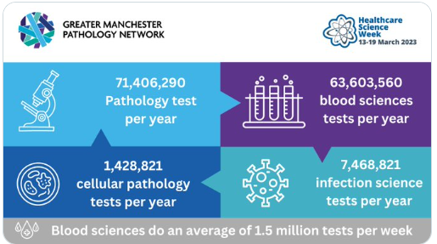
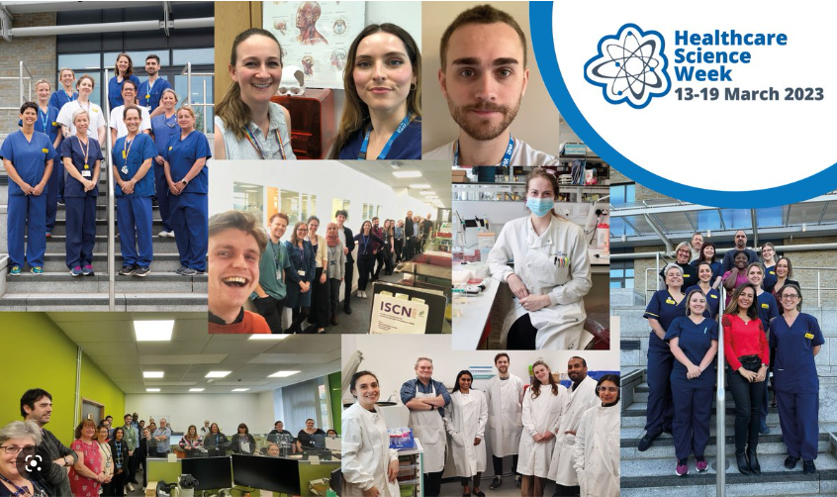
Healthcare Science Careers Showcase
Part of the Creating Careers: A Step Ahead Programme
16/03/23 5.30pm – 6.30pm

Slide 3





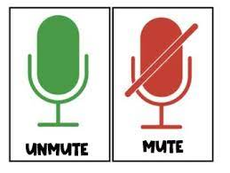

Housekeeping
Thank You

Slide 4
Agenda
5.30pm House Keeping - Introduction to Ella
5.35pm - 5.50pm Exploring Healthcare Science with Helen Liggett
5.50pm - 6.00pm – Adam Hawker - Trainee Clinical Scientist in Microbiology at Manchester University NHS Foundation Trust
6.00pm - 6.10pm – Joey Abrams -Trainee Biomedical Scientist in Cellular Pathology covering Royal Preston Hospital to Lancashire Teaching Hospitals Foundation Trust
6.10pm – 6.20pm – Dylan Smith - Cardiac Physiologist – St Helens & Knowsley
6.25pm – 6.30pm Next Steps Aspire E- Learning and Health Proof

Slide 5
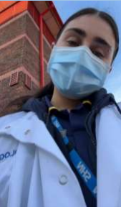

Host - Ella
2021 Integrated Masters’ Anatomy and Human Biology course
University of Liverpool
Part time St. Helen’s and Knowsley Teaching Hospitals Trust
Whiston have also given me the opportunity to turn my work in
the lab into a recognised qualification
I am currently completing a portfolio to become part of the IBMS as a registered science technician!
Why not start building your Creating Careers A Step Ahead
Portfolio with what you have learn ’t from todays webinar.

Slide 6
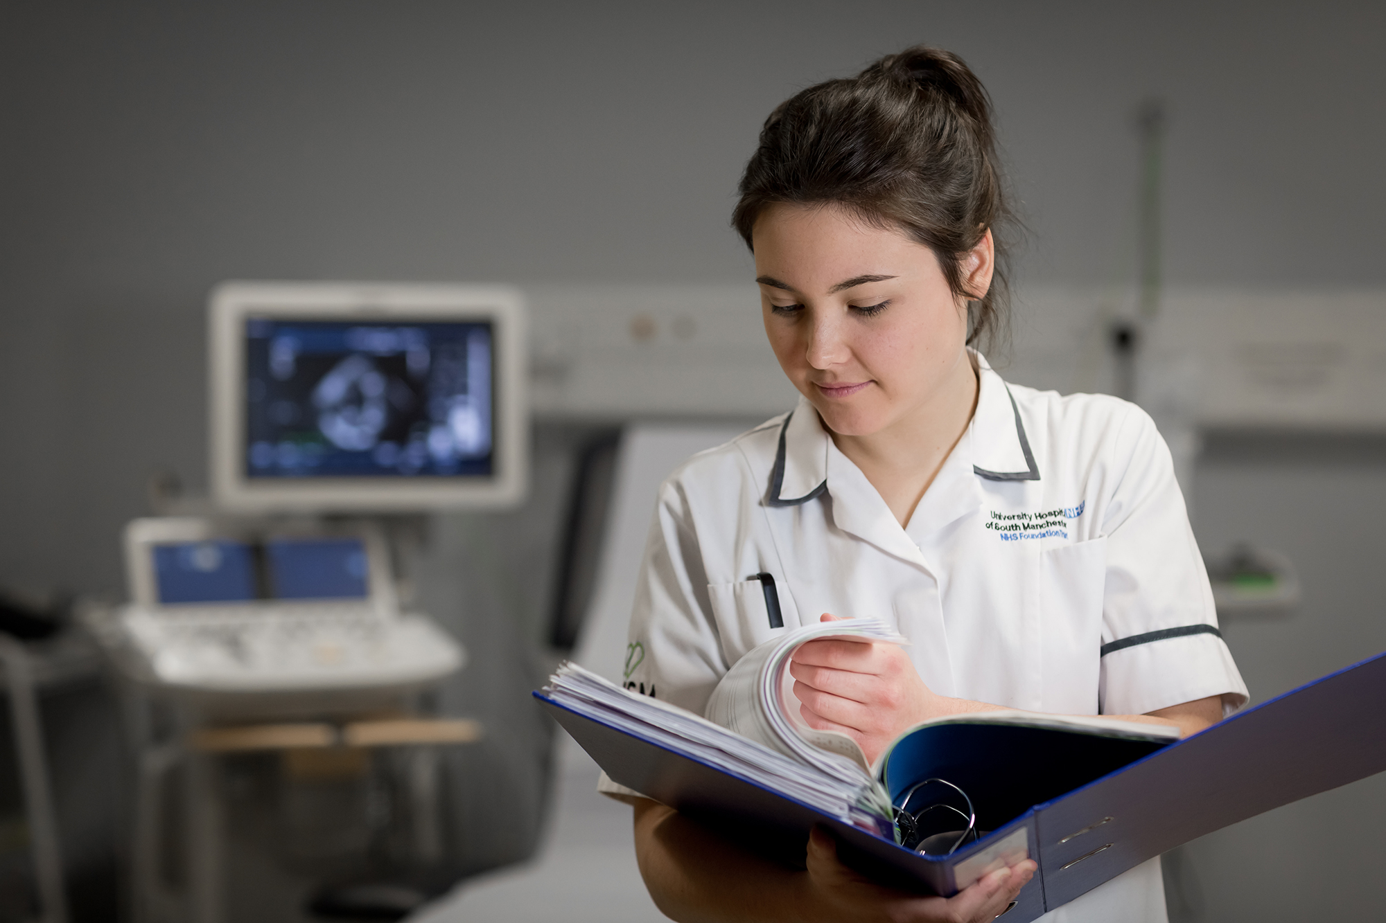
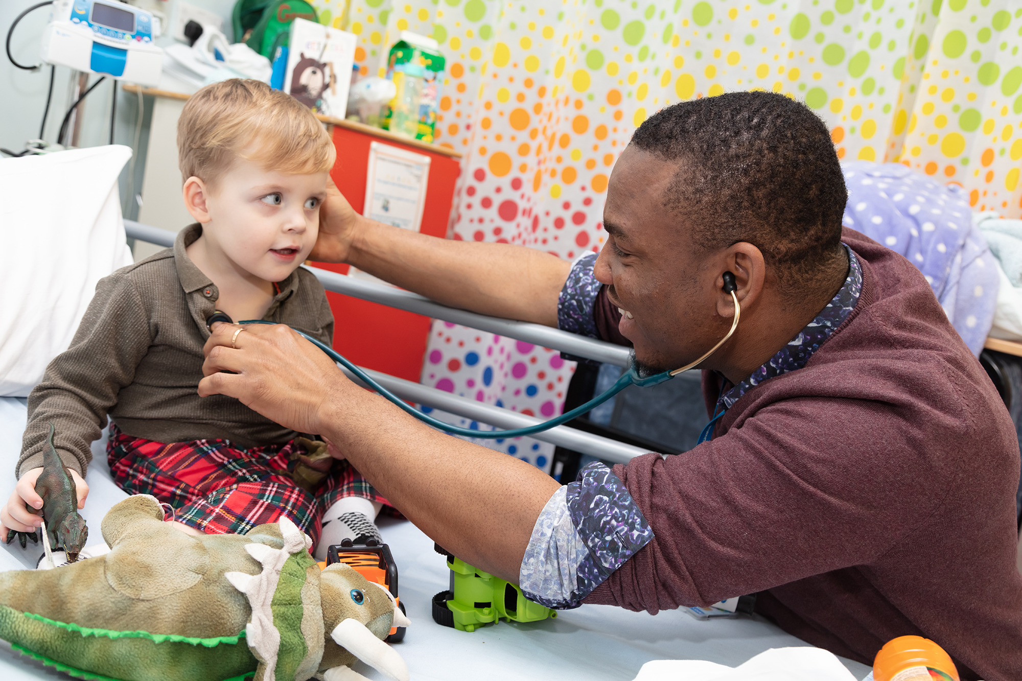
Healthcare Science Careers Showcase
Helen Liggett
NW Regional Healthcare Science Lead / Pathology Lead NHSE

Slide 7
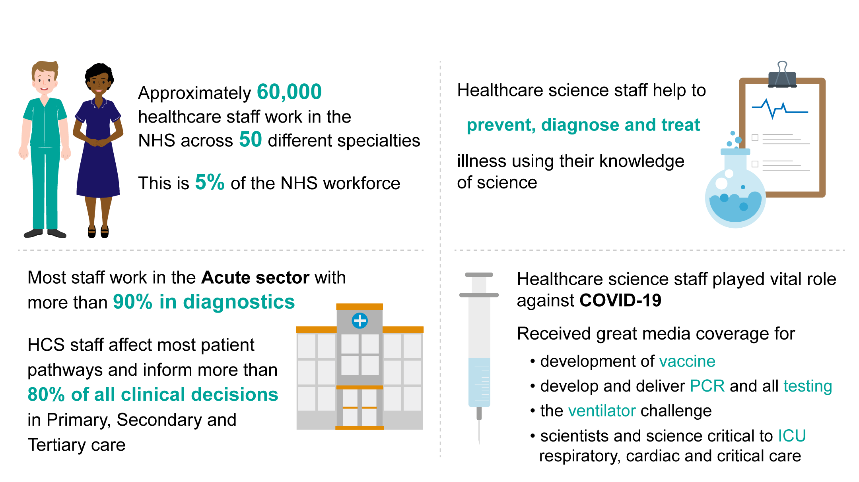
Scale and impact of healthcare science

Slide 8
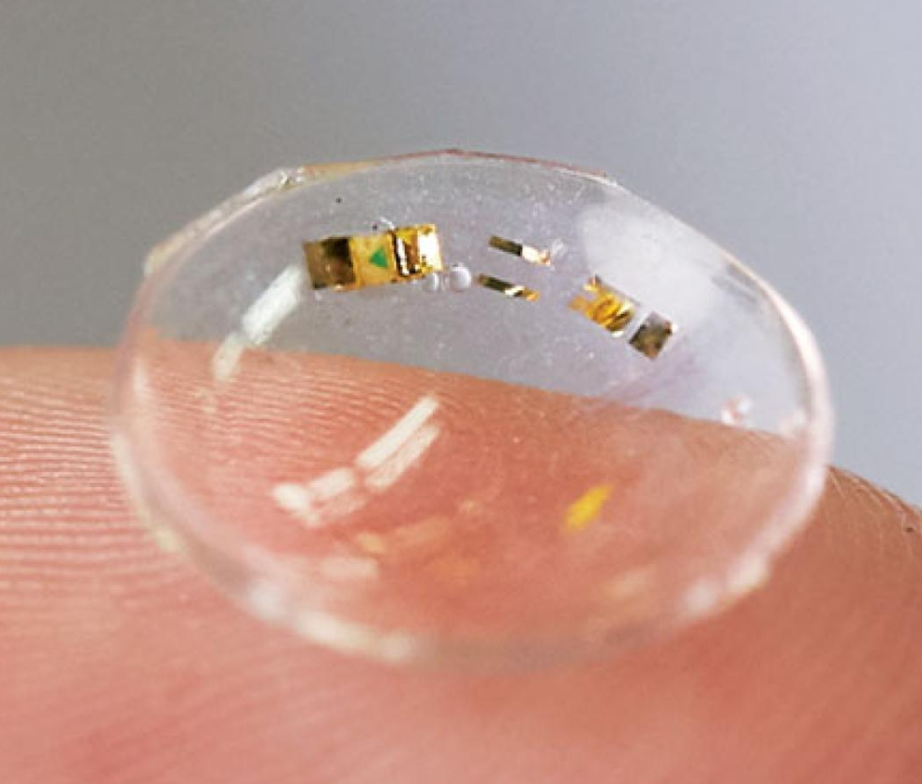
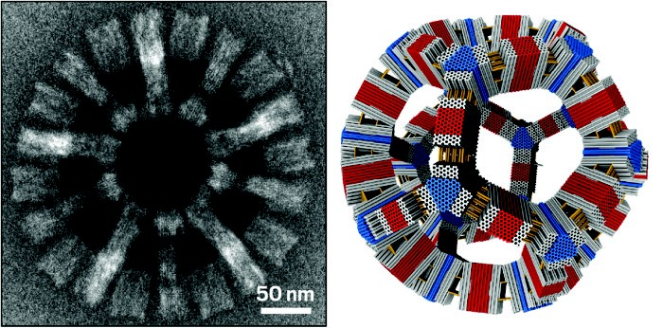
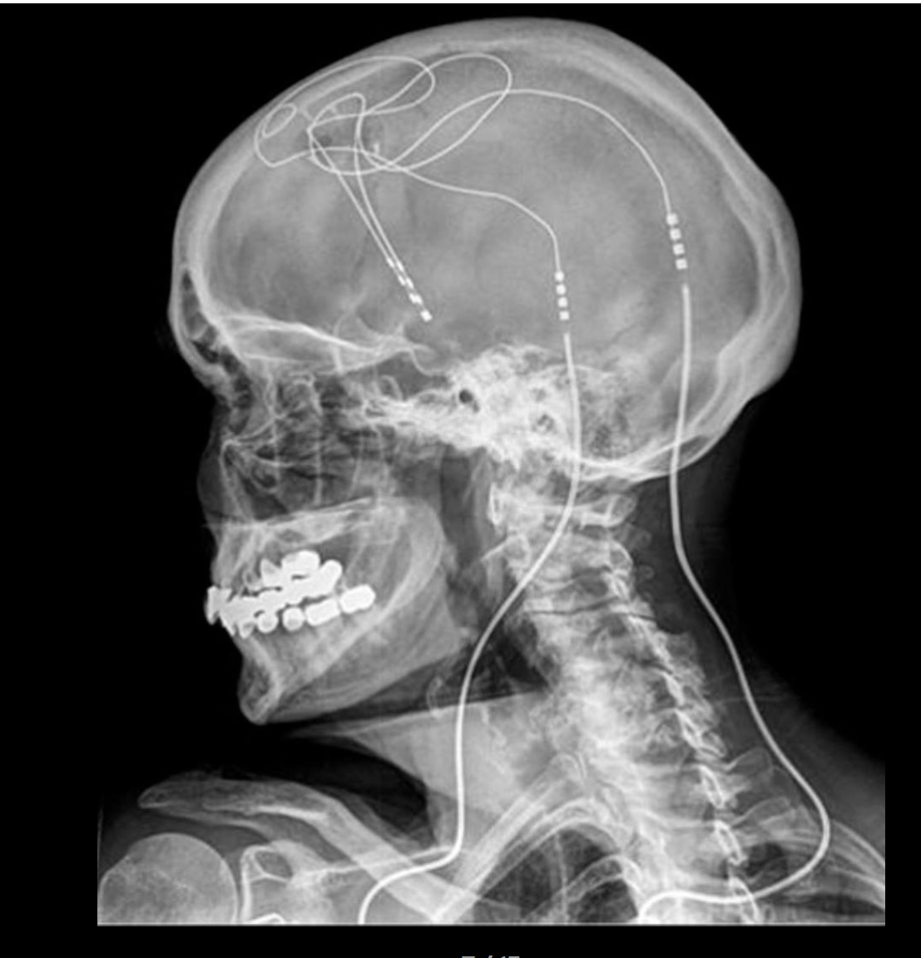


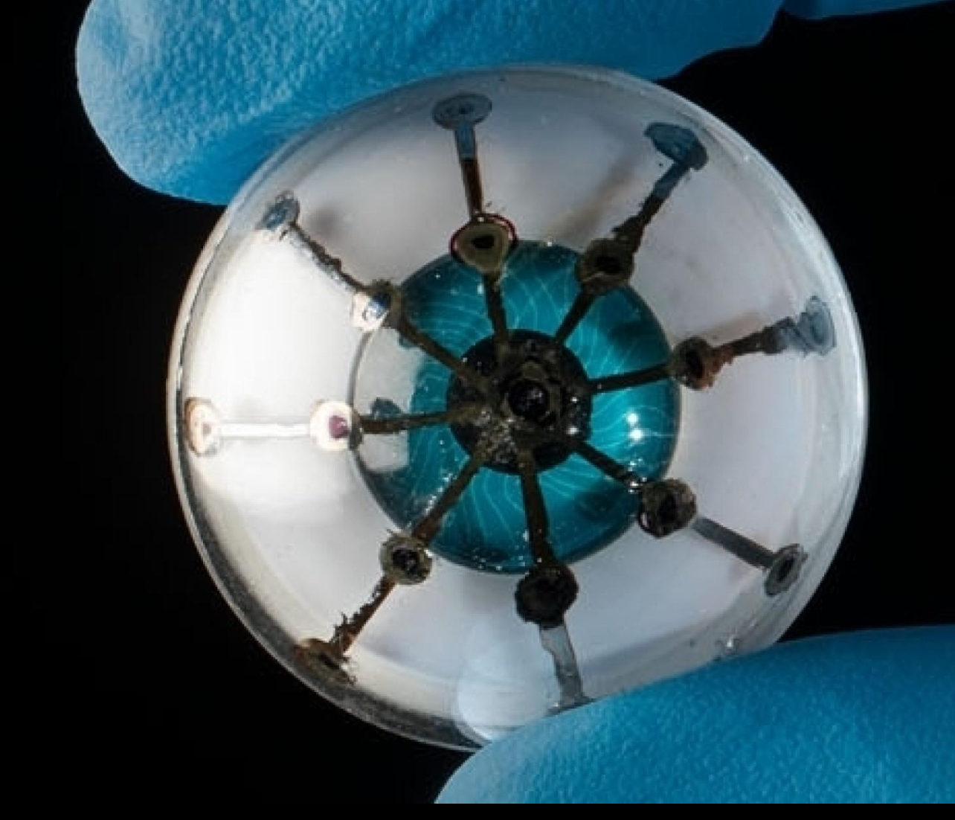
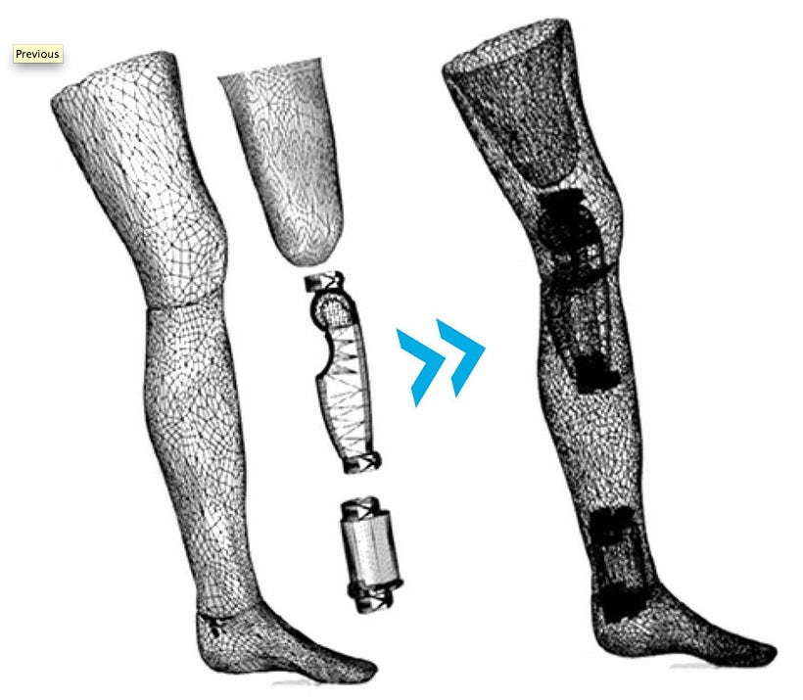
Scientific advance transforming healthcare
NSHCS trains scientists in all these areas
Glucose monitor contact lens
Wearables & biometric tech
Nanotech & Synthetic Biology
New treatment technologies
DNA ‘origami’
Deep brain stimulation
Apps &
Mobile Health
Robotics
AI & data
Pancreatic Cancer detection App
Origami robot
Genomics & Next-gen diagnostics
3D printing & bioprinting
3D printed
prosthetic
3D-printed ‘Bionic Eye’

Slide 9

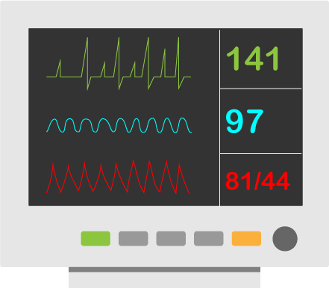


The different areas of healthcare science
Life Sciences
Physiological Sciences
Physical Sciences
Clinical Bioinformatics

Slide 10
Life Sciences
Healthcare scientists are mainly based in laboratories.
They:
investigate diseases through blood and tissue analysis e.g diabetes, leukaemia, infections, cancer
monitor patients’ response to treatments
work to find out the genetic components of illness, for example by studying DNA e.g cystic fibrosis
carry out research to identify new scientific treatments for cancer and other diseases

Slide 11
Physiological Sciences
Healthcare scientists working in this area, often work directly with patients to measure and monitor particular conditions.
For example:
carrying out electrocardiograms (ECGs) to check how the
heart is working
undertaking diagnostic tests to assess lung function
measuring eye function and taking images of the eye
assessing hearing and balance function
investigating the nervous system to diagnose and monitor things like epilepsy, stroke, dementia and multiple sclerosis
helping patients with sleep problems

Slide 12
Physical Sciences
Healthcare scientists working in this area, will have some direct patient contact and will also work behind the scenes on all sorts of equipment.
working with people with a disability to provide the equipment they need: wheelchairs, artificial limbs, electronically assisted speech, other robotic aids
designing instruments and equipment to monitor patient’s progress
maintaining and servicing machinery such as dialysis machines
making sure that equipment used in radiotherapy delivers the correct dosages

Slide 13
Clinical Bioinformatics
Bioinformaticians ensure that any data received and generated by the laboratory, is used in an efficient, standardised, secure and accurate manner.
Informatics in healthcare science is broken down into three unique areas:
Clinical Bioinformatics – Genomics
Clinical Bioinformatics - Health Informatics
Clinical bioinformatics - Physical Sciences

Slide 14

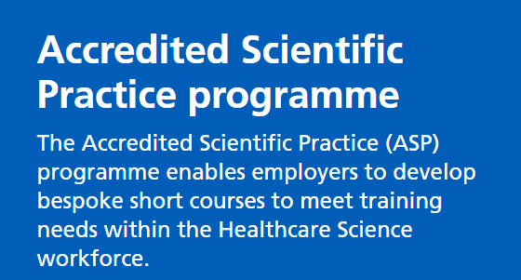
Check the qualifications of where you want to study, before you choose an unaccredited course ?
The National School if Healthcare Science is part of Health Education England (HEE) and has national responsibility for the education, training and development of all healthcare scientists in the NHS, from apprentices to consultant grade. The School has pioneered national scientist training in UK, producing scientists who are changing patient and clinical outcomes, contributing to multi-professional working and leading in many areas of innovation and translational research in the NHS.
Find an accredited course that suits your needs
Click the picture to find out more

Slide 15



Thinking of applying for an undergraduate course ?
Potential applicants for undergraduate courses should look for National School of Healthcare Science accreditation or Institute of Biomedical Science accreditation. For science careers that require HCPC registration, such as life sciences (biomedical sciences), applicants should look for courses that meet the educational standards (SETs) of the Health & Care Professions Council (HCPC). These are termed HCPC approved programmes.
Look out for these logos when searching courses.
Health & care professions council (HCPC)
Institute of Biomedical Science
National School of Healthcare Science
Notes:
Encourage students to look out for these logos on any course they are interested in

Slide 16
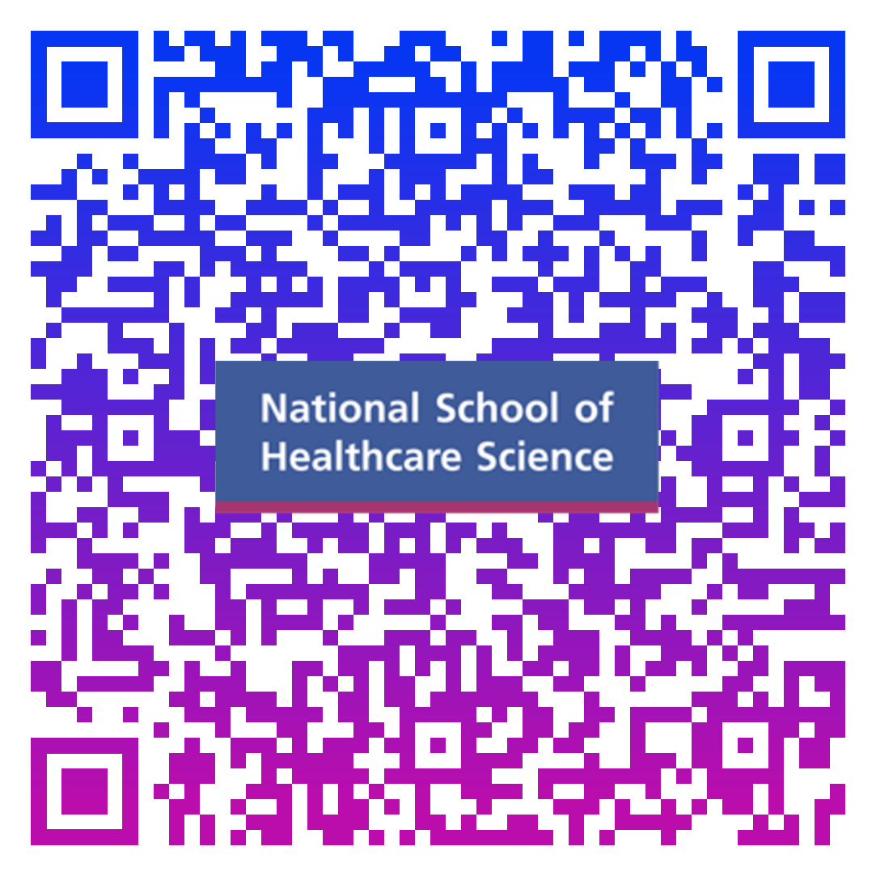
North West Accredited Courses

Slide 17
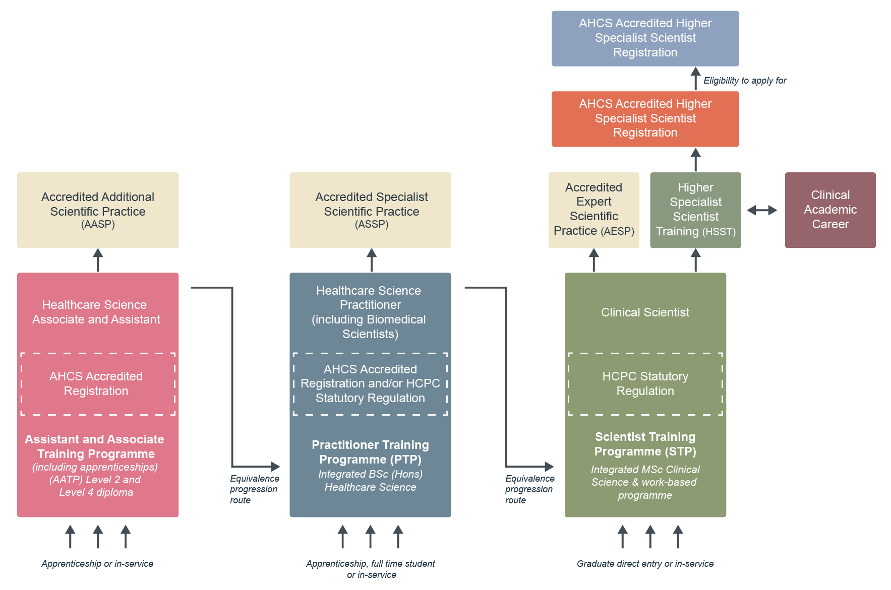
Career and training pathways

Slide 18
How to become a healthcare scientist
There are various routes into becoming a healthcare scientist, depending on your entry level.
T Levels - a two-year qualification that include a 45-day industry placement
Apprenticeships - full-time employment combined with classroom learning
Practitioner Training Programme (PTP) - a three-year BSc honours undergraduate training programme
Scientist Training Programme (STP) - a three-year MSc honours undergraduate training programme
Higher Specialist Scientist Training (HSST) - a bespoke five -year doctoral level

Slide 19
T Levels
T Levels are new courses which follow GCSEs and are equivalent to 3 A levels. Healthcare Science T Levels are available for delivery from September 2021.
T Levels offer students a mixture of classroom learning and ‘on-the-job’ experience during an industry placement of at least 315 hours (approximately 45 days).a unique part of T Levels will be the completion of a high-quality industry placement – of at least 315 hours, or approximately 45 days
Allows students to build the knowledge and skills they need in a workplace environment
Structured and assessed work for students to achieve
Working closely with learning provider to organise placement

Slide 20
Apprenticeships
An apprenticeship is a program that trains a worker to become skilled in a particular profession. Apprenticeships combine hands-on work with classroom learning. Apprenticeships are usually in full-time employment. As the apprentice is learning, they are also applying the lessons through working.
There are different levels of healthcare science apprenticeships you can undertake:
Healthcare Science Assistant (Level 2)
Healthcare Science Associate (Level 4)
Degree apprenticeship – Healthcare Science Practitioner (Level 6)
Degree apprentices – Clinical Scientist (Level 7)

Slide 21

More roles than you think !

Slide 22
40 scientific specialties (HSST & STP)
Division | Theme | Specialty
Physiological Sciences | Cardiac, Vascular, Respiratory & Sleep Sciences | Cardiac Science
 |  | Vascular Science
 |  | Respiratory & Sleep Sciences
 |  | Critical Care Science
 |  | Gastrointestinal Physiology
 | Neurosensory Sciences | Audiology
 |  | Neurophysiology
Pathology & Genomics | Infection Sciences | Microbiology & Microbial Genomics
 | Blood Sciences | Clinical Biochemistry
 |  | Haematology and Transfusion Science
 |  | Clinical Immunology
 |  | Histocompatibility & Immunogenetics
 | Cellular Sciences | Andrology
 |  | Reproductive Science
 | Genomic Sciences | Genomic Counselling
 |  | Genomics
 |  | Cancer Genomics
Physical Sciences | Medical Physics | Radiotherapy Physics
 |  | Radiation Safety and diagnostic radiation
 |  | Imaging (ionising radiation)
 |  | Imaging (non-ionising radiation)
 |  | Medical Physics Un-defined
 | Clinical Pharmaceutical Science | Clinical Pharmaceutical Science
 | Clinical Engineering | Rehabilitation Engineering
 |  | Clinical Measurement & Development
 |  | Device Risk Management & Governance
 |  | Clinical Engineering Un-defined
 | Reconstructive Sciences | Reconstructive Science
Informatics | Clinical Bioinformatics | Clinical Bioinformatics (Genomics)
 |  | Clinical Bioinformatics (Physical Sciences)
 |  | Clinical Bioinformatics (Health Informatics)

Slide 23
40 scientific specialties (HSST & STP)
Life Sciences |  |  | Life Sciences | Physical Sciences |  | Physiological Sciences |  |  | Informatics
Infection Science | Blood Science | Cellular Science | Genomics Genetic Sciences | Medical Physics | Clinical Engineering | Cardiac, Vascular, Respiratory & Sleep Sciences | Gastro- intestinal Physiology | Neurosensory Science | Clinical Bioinformatics
Microbiology | Clinical Biochemistry | Reproductive Science Embryology | Genomics | Radiotherapy Physics | Reconstructive Science | Cardiac Science | Gastro- intestinal Physiology | Audiology Entry requirements | Clinical Bioinformatics Genomics
Virology | Clinical Immunology | Reproductive Science Andrology | Genomic Counselling | Imaging (ionising radiation) | Rehabilitation Engineering | Vascular Science | Urodynamic Science | Ophthalmic & Vision Science Entry requirements | Clinical Bioinformatics Physical Sciences Entry requirements
Molecular Pathology of Infection | Haematology & Transfusion Science | Histopathology | Cancer Genomics | Imaging (non ionising radiation) | Clinical Measurement & Development | Respiratory & Sleep Science |  | Neurophysiology | Clinical Bioinformatics Health Informatics
 | Histocompatibility & Immunogenetics | Molecular Pathology of Acquired Disease | Genetics Working life (clinical genetics ) | Nuclear Medicine | Medical Device Risk Management & Governance Entry requirements | Critical Care science Entry requirements
 | Haematology |  |  | Radiation Safety & Diagnostic Radiology
 | Analytical Toxicology |  |  | Pharmaceutical Science
Notes:
We are key to delivering excellent training for all of these scientific specialties and have HEE funded STP and HSST programmes for all of these
We also have apprenticeship programmes at levels 2, 4, 6, 7,
We also have PGCert programmes either running or in development for subjects such as Echocardiology, Respiratory physiology, Sleep physiology, for sports scientists, nurses, radiographers as well as healthcare scientists
We also are developing a pioneering PG Diploma in CLINICAL DATA SCIENCE with the Christie and Univ of Manchester and we are co-creating this with HEE Medics, dentists,nurses, pharmacists, Library , AHPs.

Slide 24
Practitioner Training Programme (PTP)
The programmes involves broad scientific training in the first two years with an increased focus on a chosen specialism during year three. Whilst on the programme you will complete a BSc (Hons) in Healthcare Science.
Workplace
University
Work based induction & mandatory training
Completion of work based competencies and portfolio
Research project
University teaching and assessment in HCS science, specialism specific, professional practice, research methods

Slide 25
Scientist Training Programme (STP)
The STP is a full-time, three-year programme commissioned by HEE with approximately 300 places annually. Salary and university fees are funded.
Workplace
University
Work based training
Practical training and assessment
Contract of employment
MSc in Clinical Science
Academic teaching and assessment

Slide 26
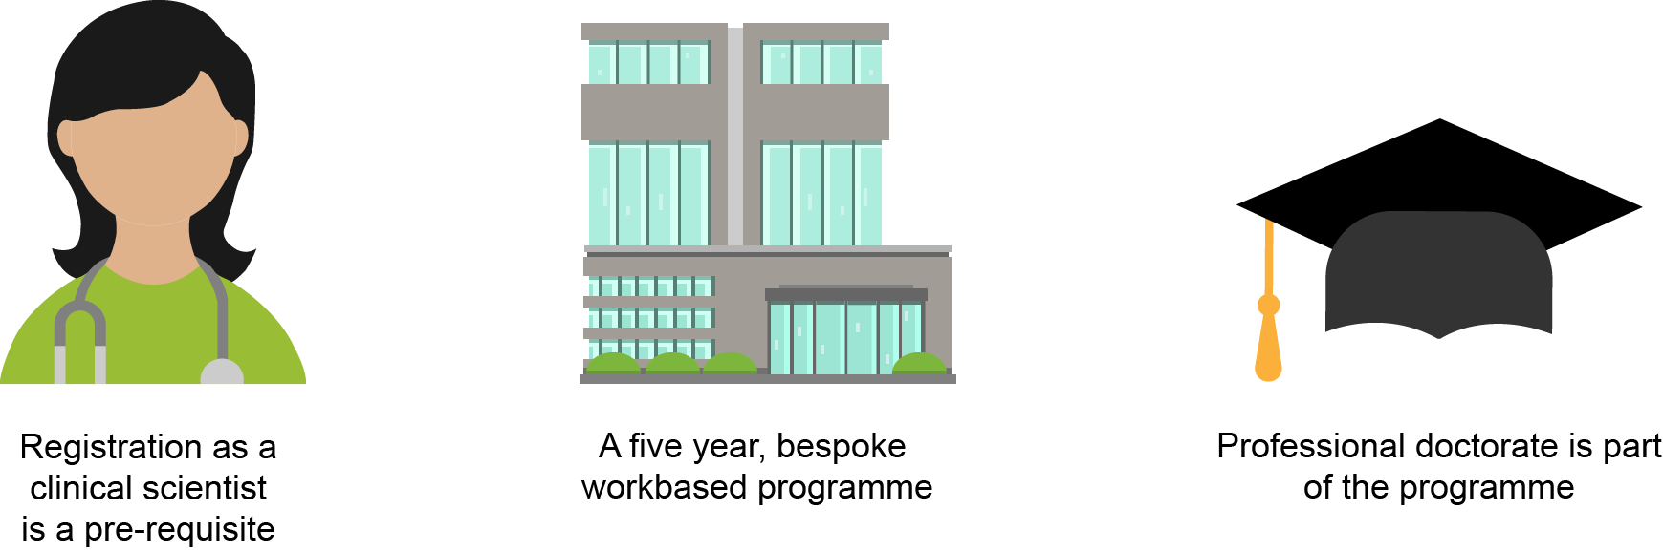
Higher Specialist Scientist Training (HSST)
The HSST is a bespoke five-year, work-based programme aimed at consultant clinical scientists. Applicants must already be a registered clinical scientist or agreed equivalent.

Slide 27
Find out more
Visit the National School of Healthcare Science website to read about the programmes www.nshcs.hee.nhs.uk
Watch interviews with past and present trainees and apprentices at www.nshcs.hee.nhs.uk or at the Health Careers website www.healthcareers.nhs.uk/explore-roles/healthcare-science
Visit the Skills for Health website and find out about apprenticeships a https://www.skillsforhealth.org.uk/services/item/727-apprenticeships

Slide 28
How to apply
Apprenticeships
Via the NHS Jobs website www.jobs.nhs.uk
When searching on the NHS Jobs website, we recommend that you search using ‘healthcare science apprentice’
PTP
Via the UCAS website www.ucas.com
When searching on the UCAS website, we recommend that you search using ‘healthcare science’

Slide 29
How to apply
STP
Via the National School of Healthcare Science www.nshcs.hee.nhs.uk
Degree in a relevant subject
Relevant skills and knowledge
Research experience
HSST
Via the National School of Healthcare Science www.nshcs.hee.nhs.uk
Clinical Scientist registration
Direct entry route
In-service route

Slide 30
Any Questions

Slide 31
Ambassador
Adam Hawker - Trainee Clinical Scientist in Microbiology at Manchester University NHS Foundation Trust

Slide 32
Ambassador
Joey Abrams -Trainee Biomedical Scientist in Cellular Pathology covering Royal Preston Hospital to Lancashire Teaching Hospitals Foundation Trust

Slide 33
Ambassador
Dylan Smith - Cardiac Physiologist – St Helens & Knowsley

Slide 34
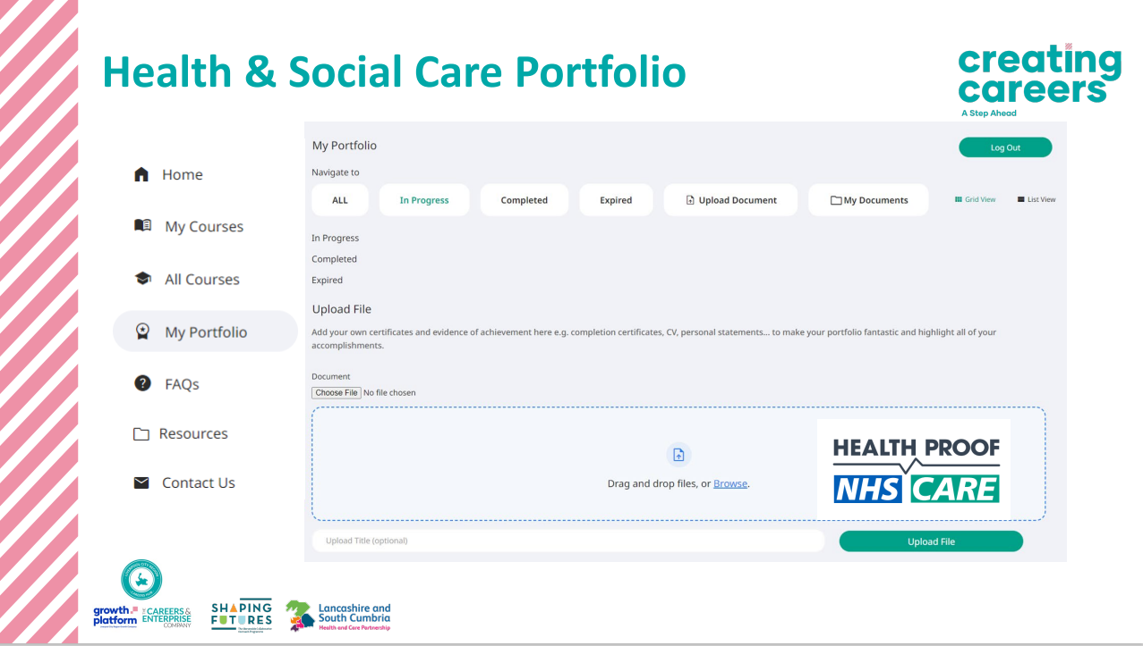
Next Steps

Slide 35

Support

