Slide 1
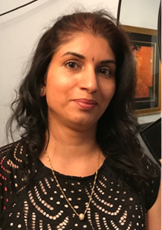
Occupational Therapy Celebration Day
I chose to become an Occupational Therapist (OT) because I enjoy the process of enabling people to regain and return to their occupation and restore function through therapy.
At present I am Working within the reablement Adult Social Care at a Grade 8, equivalent to a band 5 in the NHS. I am within my 1 year post graduation and this is first post. I enable people to become independent using a strengths-based approach. I encourage people to do more of what they can and grading and adapting activities where they need help. I plan therapeutic input to regain functional strength and stamina.
What’s the best thing about being an Occupational Therapist?
Working within the community I get to meet different people from all walks of life with varying needs, life stories and experiences.
I get to visit people at their home and see them in their own environment, which helps to complete a holistic assessment.
Why become an Occupational Therapist?
You should become an Occupational Therapist because you get to -
Enhance a person's quality of life.
Work with all types of people with various health conditions and needs.
Be creative in your therapeutic approach, making exercise fun and achievable.
Work in a holistic manner with a person-centred approach
Mrs Trupti Parmar
Occupational Therapist
Reablement – Adult Social Care

Slide 2
Occupational Therapy Celebration Day
My student placements were interesting and varied: I had a placement in a medium secure forensic unit, a community placement in burns and plastics, an inpatient stroke rehab placement and a role-emerging placement on a care-farm working with teenagers with autism which I arranged myself. As a student, I volunteered for a Malawi based OT charity, helping to establish this as a Project Manager and I had an active role in the OT Frontiers organisation, attending monthly meetings which allowed networking opportunities
After graduating, I gained a band 5 rotational post at Salford Royal Hospital where I worked in Aging and Complex Medicine, and Neurosurgery. After this, I moved to Royal Lancaster Infirmary to be closer to home and I have completed rotations in Medicine and Orthopaedics before gaining a band 6 role at the RLI on the Rehab wards.
My current role is challenging but enjoyable, and feel that my varied background has helped me gain both life experience and knowledge which has helped me throughout my training and career so far. My current role includes lots of functional and cognitive assessments, working with the physiotherapy team to provide rehab, and liaising with the hospital MDT -and patients and their families- to help safely assess and discharge plan when people are ready to leave the hospital.
What’s the best thing about being an Occupational Therapist?
No day is the same –it is very person-centred and holistic, and it's great seeing patients you work with build confidence and strength to be able to independently manage things that are important to them.
Why become an Occupational Therapist?
'Occupation’ can mean anything and everything that is meaningful to a person so it is a very varied and flexible career. It's never boring and there's lots of opportunities in a range of areas.
Sophie Baqai
Occupational Therapy

Slide 3
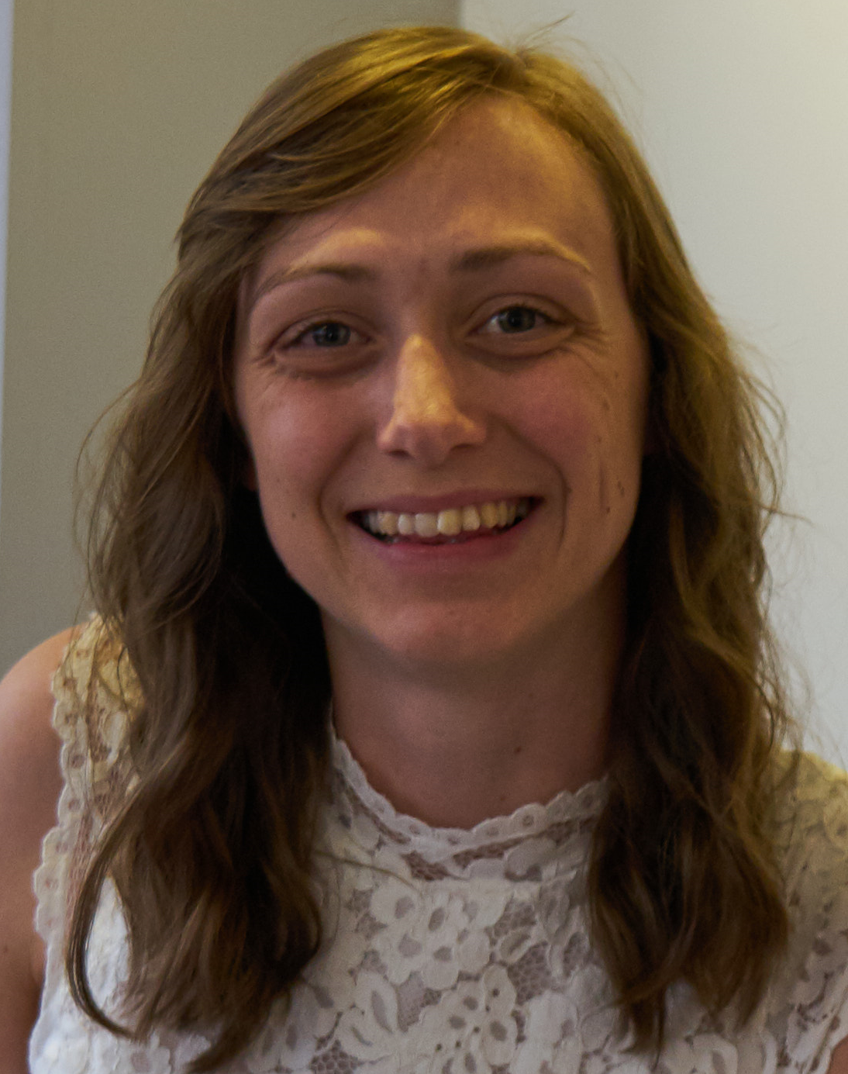
Occupational Therapy Celebration Day
As a newly qualified OT, I got a job in adult social care as a community Occupational Therapist. This role involves assessing people in their homes and providing equipment and adaptations. I enjoy that there is a focus on supporting people to remain at home if they would like and can. There is also a focus on increasing independence and supporting people to do as much as they can. Another focus is using equipment to reduce care packages and support carers. This is so important as social care struggles to recruit carers and it also allows for more flexibility and consistency with care packages. When I applied for this job, I never expected to remain in it for so long, but I really enjoy it. The role is varied and challenging as no person and their circumstances is the same as another.
Although I still work in adult social care, I have recently changed to a different team. This team still assesses for and provides equipment and adaptations. However rather than being for all adults, it specialises in supporting people home from care homes and advises in cases related to safeguarding. The role is a senior OT position so also involves supervising and team development.
I am someone who enjoys their job and cannot imagine being anything other than an Occupational Therapist.
What’s the best thing about being an Occupational Therapist?
I love meeting lots of different people and supporting them in a practical way to improve quality of life.
Why become an Occupational Therapist?
The aim is to improve life and access to the things people enjoyed and needed rather than simply improving health. This stood out as very different from other health care roles and what attracted me to being an Occupational Therapist.
Sonja Mechie
Occupational Therapist

Slide 4
Occupational Therapy Celebration Day
I started on Occupational Therapy when I successful in gaining a band 5 rotational OT. The rotations I completed included surgery and amputees, medical and orthopaedics. My favourite development area whilst a band 5, was amputee rehabilitation. I remained on the rotation for 5 years, after which I was successful in gaining a band 6 role within older adult’s rehabilitation at Rehabilitation hospital.
I have continued to developed my assessment skills in cognition and activity analysis. My knowledge has deepened into the links of the patient, condition, and function. Clinical reasoning skills have developed ten-fold due to the complexity of the patient within the rehabilitation setting. I provide supervision to junior members of the team and happily provide training to the team under the umbrella of dementia and cognition.
I have expanding my role which now included a Basic Life assessor, a Dementia Champion, as well as a Safeguarding and DOLS champion. I provide training sessions on dementia to assistants and OT’s.
Whilst my career has developed, so has the academia. I have gained a MSc in Advanced Occupational Therapy as well as MSc in Dementia Studies. Having these post graduate qualifications have assisted with progressing into the band 6 roles and being competent within the specialised areas of work.
What’s the best thing about being an Occupational Therapist?
Supporting people to be as independent as possible and focus on what the individual feels is most important to them.
Why become an Occupational Therapist?
I particularly liked the fact that I could venture into both Mental Health and Physical.
Sandra Green
Occupational Therapist

Slide 5
Occupational Therapy Celebration Day
I worked as an Associate Practitioner at a medium secure mental health unit in Preston. My main duties included psychological therapies and counselling for the patients. This is where I first remember coming into contact with Occupational Therapists as they were the ones who ran all the activities such as art, woodwork, gardening, etc. I always much preferred their job as they always seemed to have all the fun going out shopping, or cooking, or even ten pin bowling!
I graduated in 2020 in the middle of the COVID pandemic and went straight from my last NHS practice placement in hospital to my first job with Reablement in Adult Social Care.
I am still in this current role and enjoy it so much as I can utilise all the skills and knowledge, I learnt at university about activity analysis and problem solving in a holistic way. I enjoy going out to visit people, finding out who they are and what I can do to support them to live at home safely. Together we work towards goals to increase their independence in completing meaningful daily activities which helps to improve their quality of life.
What’s the best thing about being an Occupational Therapist?
Why become an Occupational Therapist?
Rupesh Nayee
Occupational Therapy

Slide 6
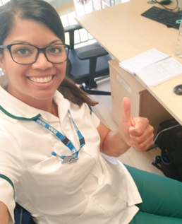
My Profile
I decided to become an Occupational Therapist (OT) at the age of 16!!! I was interested in Healthcare but wasn’t sure which role – the careers advisor spoke to me about what subjects I enjoyed, my personality and interests and matched me to OT. I shadowed a few places and never looked back The prospect of a secure job in the NHS and the diverse areas that OTs can work in physical and mental health attracted me to the profession.
After graduating I completed a rotation post within the local acute hospital and then became a Senior OT on the acute orthopaedics unit. A secondment opportunity came up shortly after for a new pilot – joint initiative between the NHS and Department of work and pension (at the jobcentres) known as Pathways to work. As an MDT we were enabling people with long term conditions who weren’t able to work better manage their health which I found very interesting. After this the majority of my OT experience has been in community rehabilitation in particular Respiratory. In 2011 I had a child and a spell of unexpected ill health in 2017, work has been flexible and I had great support. Over my working years I have taken up lots of CPD opportunities, training etc. in particular completing some post grad modules, ad hoc teaching opportunities at universities, writing an article for the OT news, quality improvement projects in the Trust, leadership courses, and health coaching skills. Then in 2019 I got my first Band 7 post as clinical lead OT.
At present I am a Clinical Lead OT on a new therapy led intermediate care unit – Albion Mill. This is a new integrated rehab unit with partnership working with NHS, social care, GPs etc. My job role is very diverse and involves operational management of therapy staff day to day and service development and quality assurance, ensuring quality services are delivered and audited and improvements made where necessary. I also provide supervision to all the OTs both in 1:1 and groups, ensuring all latest OT practice in intermediate care is embedded on the unit. I work really well with the clinical lead physio, lead nurse and the CQC registered manager on the unit to provide support to the physiotherapists, therapy staff, and nurses and support workers on the unit promoting a rehab approach with all. I also support with complex cases/discharges.
What’s the best thing about being an Occupational Therapist?
The variety of job opportunities., as a OT you are dual trained in physical and mental health. Great job satisfaction from improving a persons quality of life and ability to engage in their important daily activities. Lots of training opportunities for CPD.
Working in a team and doing the best you can for a patient as an OT and getting the role and its value recognised. Job security
Professional role and identity in the working world and being a role model to inspire future prospective students to become OTs/AHPS
Why become an Occupational Therapist?
For all the reasons mentioned above and so much more! If interested in this career please speak
or go to shadow an Occupational Therapist
Priti Bhagat
Clinical Lead Occupational Therapist at Albion Mill Intermediate Care Unit (Blackburn with Darwen)

Slide 7
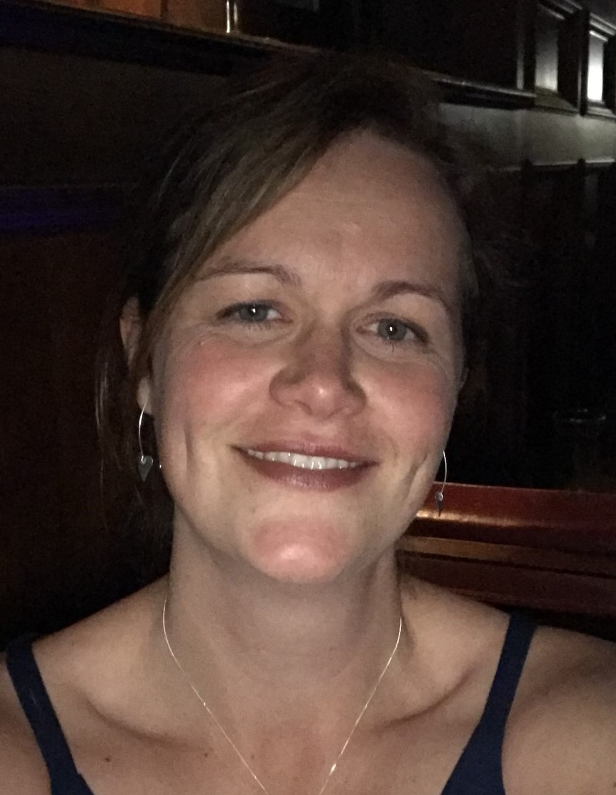
Occupational Therapy Celebration Day
I choose to become and Occupational Therapist (OT) because I wanted to support people to be as independent as possible. I completed some volunteering working with Bennardo's over the summers while at College. I wanted to have a practical, hands on job which supported people. I like to problem solve and within OT there are lots of opportunities to do this.
I started my career on a band 5 rotation across acute settings where I developed my assessment, treatment and planning skills. Then after 2 years I applied for a band 6 post within a Community Rehabilitation Centre. I complete rehabilitation within the centre but also got the opportunity to take people out into the local community to practice daily tasks. I continue to develop my confidence and expanded my role to include some community assessment and property adaptations. I then progressed to a team leader role across OT and Physiotherapy within a Rehabilitation Hospital. This role was split between clinical and managerial tasks. I learned a lot about service development/improvements and management of staff.
In my current role I working as a Project Manager role across Lancashire and South Cumbria Integrated Care System. This role support the 14 AHP professions working between Health, Social Care and Education providers across the System. Looking at cross organisation working to develop workforce initiatives, varying from Supply and Retention, Apprenticeship, Preceptorship and early professional development, Equality, Diversity, inclusion and Belonging.
What’s the best thing about being an Occupational Therapist?
It allows therapists to utilise their creative thinking skills while also relying on their knowledge of science, development, and the body/brain to be effective in their role as an OT.
Why become an Occupational Therapist?
It is a very practical job and is very varied not only between Mental Health, Learning Disabilities and the Physical settings but within the specialities. No two day are the same.
Lindsay Hetko Project manager
Occupational Therapist

Slide 8
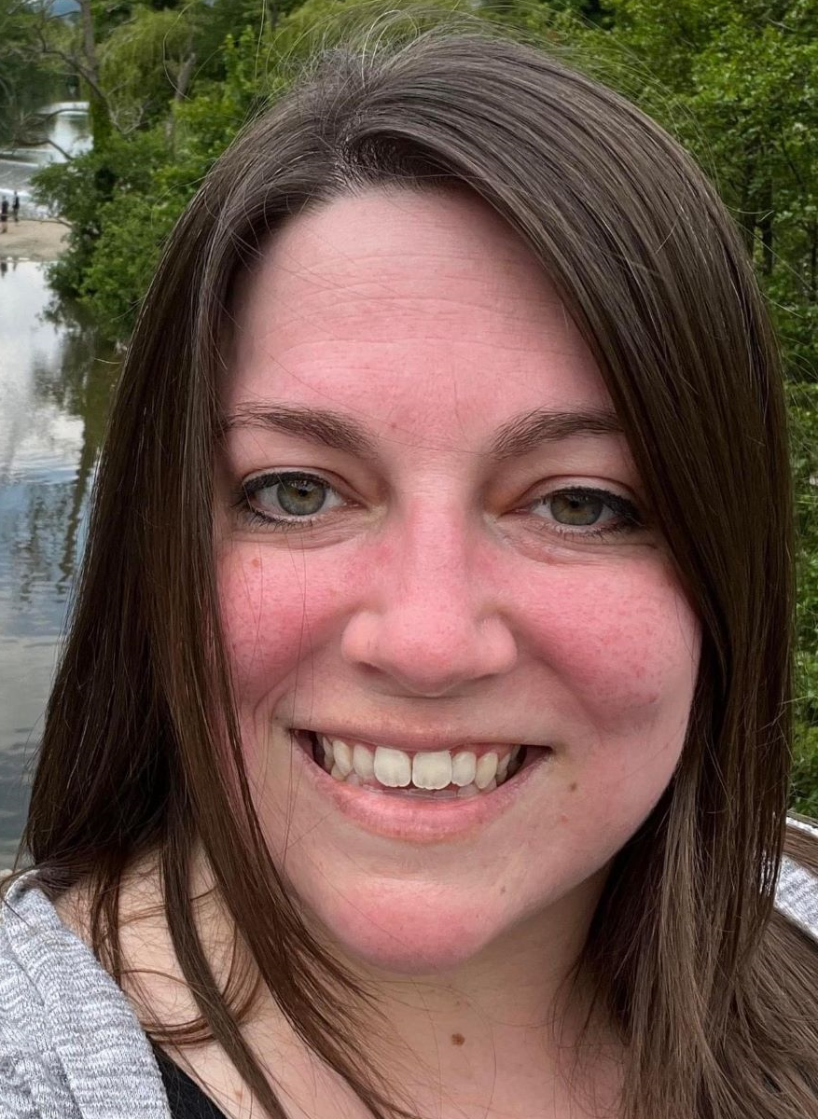
Occupational Therapy Celebration Day
I’ve always loved learning and I like sharing knowledge with others. I also love Occupational Therapy (OT) and the principles behind what we do. So, it was a natural marriage of the two to end up as a lecturer in occupational therapy.
I teach a variety of modules and sessions within the BSc (Hons) and MSc OT programmes. This includes reading information and up-to-date research, an understanding of underlying concepts in OT, and a passion for the profession and information to impart to students and motivate them so they can be well set to practice in OT. In addition to teaching, I support students academically with advising as well as visiting support on placements. There are also a variety of responsibilities around events such as interprofessional learning days for the students, welcoming prospective OT students at open days, and programme evaluation and refinement work.
I am from the United States and studied psychology for my undergraduate degree. Within that programme, I volunteered at a community centre for older adults where I led memory maintenance activities for those with mild age-related memory decline. I was interested in cognition and wanted to know how I could work with people in this way. My advisor suggested I investigate OT. I observed some therapists and found it fascinating. From there, I obtained my MSc in OT. During that programme, I found paediatric OT was a very fun and rewarding area to work in. After qualifying, I worked as a school-based OT for 6 years. During that time, I decided to move to the UK and was glad to be in a profession that qualified for visa sponsorship. I moved to England and worked in an NHS community paediatric service for nearly 2 years. While there, a visiting tutor and I connected and during an RCOT conference I messaged her. We chatted briefly which led her to informing me about an open position at the university. I have always wanted to teach and it was an exciting opportunity. I have now worked at the University for almost a year and am very pleased with this career shift, more satisfied in my work life than I have ever been. I am excited to continue to teach and encourage future waves of Occupational Therapists!
What’s the best thing about being an Occupational Therapist?
The best thing about being an OT is working alongside people and supporting them in their vulnerable moments to meet their wants and needs; their happiness or satisfaction at meeting those goals to do what they want and need to do is very rewarding. What makes OT great is our truly person-centred and holistic focus; considering the whole person, the things they want/need to do, and their environment rather than a narrow scope of circumstances or symptoms.
In lecturing, the best thing is being able to dive into all the theory, information, and discussion about occupational therapy as a profession and share this knowledge with learners who are also growing their understanding and passion for the profession. What makes lecturing great is seeing the understanding growing within students as they go through the programme, the connections they make of information with practice and how this will be implemented in their future, and of course seeing them graduate and go on to be occupational therapists.
Why become an Occupational Therapist?
OT is a rewarding profession in which you can consider many factors and many solutions to support people in their goals for their lives. It’s a joy to be a positive support to someone through part of their life journey. Becoming a lecturer is another way to support people in
their goals by providing the knowledge and enthusiasm for OT so they can start a rewarding career journey of their own.
Kristina Babbitt
Lecturer in Occupational Therapy, University of Central Lancashire

Slide 9
Occupational Therapy Celebration Day
My job is incredibly varied. No two days are ever the same.
I work part time for LSCFT as Lead OT in a child and adolescent mental health (CAMHS) unit. I have worked for the trust for 2.5 years now. The rest of the week, I work between community CAMHS and a day’s independent practice in a special educational needs (SEN) school for young males with autism. Prior to that, I have worked in various OT settings, including an acute medical hospital, care homes and other SEN schools.
I whole-heartedly recommend anyone interested in making other people’s lives better, to consider OT as a profession. OT is gaining more and more notoriety as an important role in healthcare, maybe because of society growing in its understanding of ‘occupation’ (certainly during Covid-19) as being central to our wellbeing. Come and join our OT community.
What’s the best thing about being an Occupational Therapist?
OT is such a person centred and wide-ranging profession, which not only considers someone’s medical needs, but also their physical, developmental and mental health.
Why become an Occupational Therapist?
OT truly inspiring. It is a practical therapy, enabling people to understand what they need and want to do to function in everyday life.
Charlotte Kempster
Lead OT in a Child and Adolescent Mental Health (CAMHS)

Slide 10
Occupational Therapy Celebration Day
I worked as a rehab support worker for many years within a community service and it was there where I became introduced to the world of AHP! I worked with patients in their own homes completing therapy programs from the Speech and Language Therapist, Occupational Therapists and Physiotherapists. It was during this time that I feel in love with the role of Occupational Therapy, and I was lucky enough to have the support from my team and management to change my contract to a flexible work pattern and commenced my part time degree at the age of 27.
I have been an Occupational Therapist for nearly 7 years now, spending the majority of this time in stroke. I have a passion for occupational science and enabling stroke survivors to complete occupations that they need to do and want to do, alongside the therapeutic use of activities in both assessment and treatment. Activities often needing adapting or grading with the aim to increase health and wellbeing and promote independence.
What’s the best thing about being an Occupational Therapist?
Working alongside patients in a variety of assessments and treatments, no 2 days are the same!
Working in a multi disciplinary team.
Seeing patients achieve their goals or being their support if they need to adjust to new ways of doing things.
Why become an Occupational Therapist?
If you like working with people and helping them make the most of their day then Occupational Therapy is the career for you!
Alexis Cregg
Occupational Therapist

