Slide 1
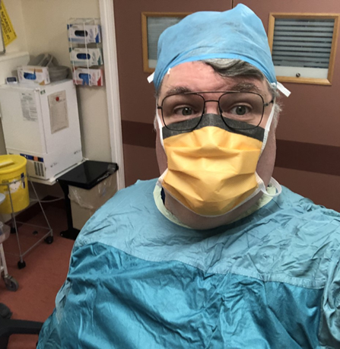
Operating Department Practitioner (ODP) Celebration Day
My role is predominantly anaesthetics and recovery, in a very busy obstetrics and gynaecology unit.
From the moment I first watched ODP's in their role, I knew that’s what I wanted to do
What’s the best thing about being an ODP?
Is being part of a fantastic team of multi skilled professionals, who's only goal is look after each patient to the highest standards.
Why become an ODP?
Each day offers new challenges, & new learning opportunities.
Rise to the challenge, start YOUR ODP journey
Roger Marsden, Sharoe Green
obstetrics and gynaecology theatres

Slide 2
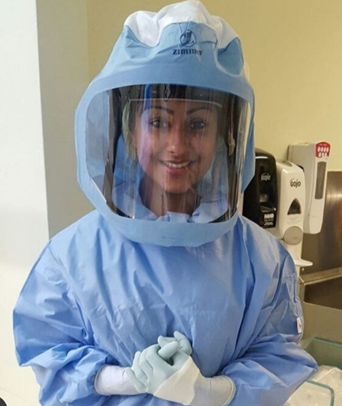
Operating Department Practitioner (ODP) Celebration Day
I worked was a ward clerk and then went into recruitment for the trust and realised that I wanted the job I was trying to get for other candidates. I wanted to progress in a career which I needed to think outside the box. So I quit my job and went back to university for a second time at 27. Being an ODP means we are skilled in many different areas. Its a life long skill.
I am a Senior ODP in Neuro theatres, I am responsible for running theatre lists, ensuring theatre efficiency, taking care of staff and looking after patients to the best of my ability.
What’s the best thing about being an ODP?
The best part of being and ODP is that I am multi skilled. Even though I am currently working in scrub, I’ll never forget how to help if there was an airway issue.
Why become an ODP?
We are an ever evolving profession, nobody knew who we were, but now due to so many fantastic qualified staff we are making ourselves known which means we have so many opportunities to progress. if you want a job that is more than just caring for patients, then become and ODP.
Rakhee, Senior ODP, Neurosurgery

Slide 3
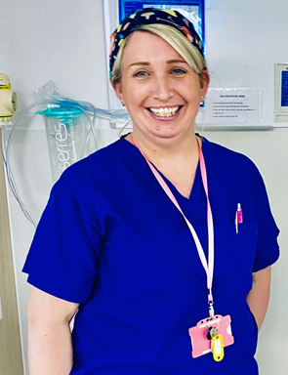
Operating Department Practitioner (ODP) Celebration Day
I started with Lancashire Teaching Hospitals as a healthcare assistant on the ward before moving to theatres as a Theatre Support Worker, I spent 8 years in this role enjoying the work I did I knew it was a natural progression for me to want to become an ODP and learn new skills. An opportunity came up for the ODP apprenticeship and I applied, I was successful in being offered a position and I’ve now nearly completed my first years training.
My current role is training for 3 years to become a fully qualified ODP. This involves studying at Bolton University and fulltime placement within the trust.
What’s the best thing about being an ODP?
Is the care which I give to patients throughout their surgical journey. Working as a team to provide the patient with holistic care.
Why become an ODP?
If you are interested in surgery, enjoy learning new skills and are caring and compassionate then the ODP role is the perfect job for you.
Kelly Boyle, Apprentice ODP, Lancashire Teaching Hospitals

Slide 4
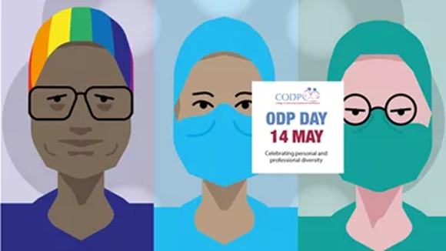
Operating Department Practitioner (ODP) Celebration Day
I worked for 3 years as a support worker in theatre. This is when I know that becoming an ODP was what I wanted to do. Being a part of a patient’s theatre experience has always been something I am very passionate about. I particularly enjoy how so many different specialist in a multidisciplinary team can all come together seamlessly to ensure theatre productivity and patient safety.
My knowledge within the department is varied and in depth. I feel competent and confident in my role. I take pride and extra measures in teaching new members of staff and passing that knowledge on to other.
I work across 3 areas: Scrubs, Anaesthetics and Recovery. I assist the doctors to anaesthetise the patient, organise and prepare sterile instruments for the surgeon and monitor patients waking up from surgery. Being an ODP allows me to follow patient right through their journey and allows me to have involvement in all aspects of their care
What’s the best thing about being an ODP?
To me, the variety and unpredictability of the job keeps me interested and every single day is completely different. OPS’s are very versatile, and can work in very high pressure situations. We work with so many talented specialists and it is an honour to be able to do this and be YOUR Operating Department Practitioner.
Why become an ODP?
If you like a challenge and have a passion to care for others when they are at their most vulnerable, this job is for you. No day is the same and the learning opportunities are endless.
Karen Jones, Band 5, Theatres Furness General Hospital

Slide 5
Operating Department Practitioner (ODP) Celebration Day
I started as a Clinical Support Worker in 2001. I know this is where I belonged and wanted to stay. I wanted to become more involved in the patient journey. I did an NVQ and then was seconded to do my ODP training at UCLAN. Once qualified I was a band 5 until I became a band 6 in 2014.
My current role is mainly working in the obstetric theatres in all the areas, anaesthetic, scrub and recover. Watching new life enter the world.
What’s the best thing about being an ODP?
Is being able to work in all three areas of the Operating department. Providing care to our patients and working alongside fantastic colleague’s
Why become an ODP?
It is a fantastic profession with amazing skills which enable you to provide amazing care
JulieAnn Mckevitt, Clinical Lead Obstetric Theatres, Furness General Hospital

Slide 6
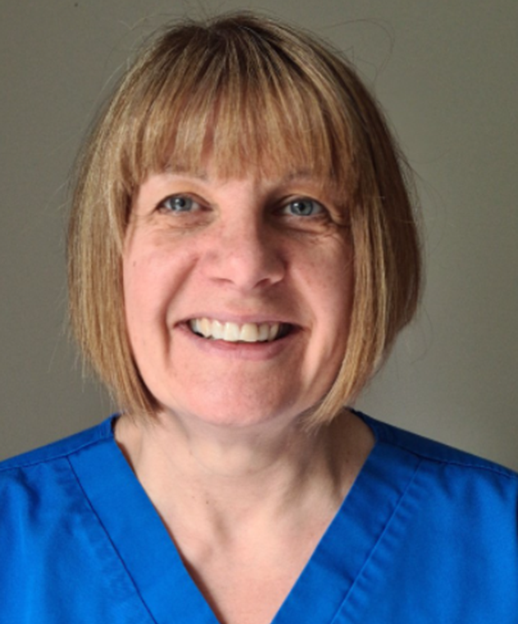
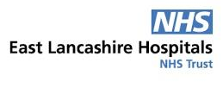
Operating Department Practitioner (ODP) Celebration Day
I started working for the NHS in 1999 as an auxiliary nurse on the bank. I then gained a permanent post on a medical ward, where I stayed for twelve months. I then moved across to being a support worker in theatre and within a few months I knew this is where I belonged. I was seconded in 2007 to do my ODP training, qualifying in 2010. I was promoted to band 6 in 2019. My main role is scrub OPD with experience in urology, vascular, max fax and general surgery. I am also part of the robot team. and mentor students and new starters
What’s the best thing about being an ODP?
Being part of the multi-disciplinary and working in a specialised area. ODP’s are great because we are part of a team that are able to give patients our undivided attention
Why become an ODP?
You get great job satisfaction and what other job allows you to wear comfortable scrubs all day.
Fiona Dunlop, Band 6 Scrub ODP Team Lead , Royal Blackburn Teaching Hospital

Slide 7
Operating Department Practitioner (ODP) Celebration Day
I always knew a 9-5 behind a desk was never for me, but I always wanted to work in healthcare. Theatres always appealed to me due to its dynamism, its ever-evolving nature, and how no two days are the same. Also scrubs are comfortable. After serving in the military as a medic I decided to come out. I was offered a few support worker jobs, but the one I decided to go with was in the Post-Operative Discharge Suite (PODS) It was connected straight to theatres and I get to meet the surgeons and anaesthetists and theatre staff and help look after patients Post op. I decided that’s what I wanted to do. Becoming an ODP I could study and work specifically in theatres. After qualifying from a university in Newcastle, I worked in orthopaedic scrub for a year while my wife finished her ODP course after taking a break to have our twin daughters. We both landed a job at Furness General where we have been ever since.
Currently, I am an anaesthetic and recovery ODP. I assist the anaesthetist in preparation for anaesthetising patients for a wide variety of elective and emergency work. This also includes obstetrics and helping out in A&E if there is an airway emergency. I also look after patients post operatively, making sure they meet discharge criteria, before they return to the ward.
What’s the best thing about being an ODP?
The best thing about being an ODP is the variety. Even if you only work in anaesthetics, there’s so many ways it can be done. General anaesthetics, Spinal anaesthetic, nerve blocks, sedation, combined with the patients individuality, no two cases are the same
Why become an ODP?
A challenging yet rewarding career that brings out the best in the people that look after patients at their most vulnerable.
Daniel Hutton ODP anaesthetics and Recovery, Furness General Hospital

Slide 8
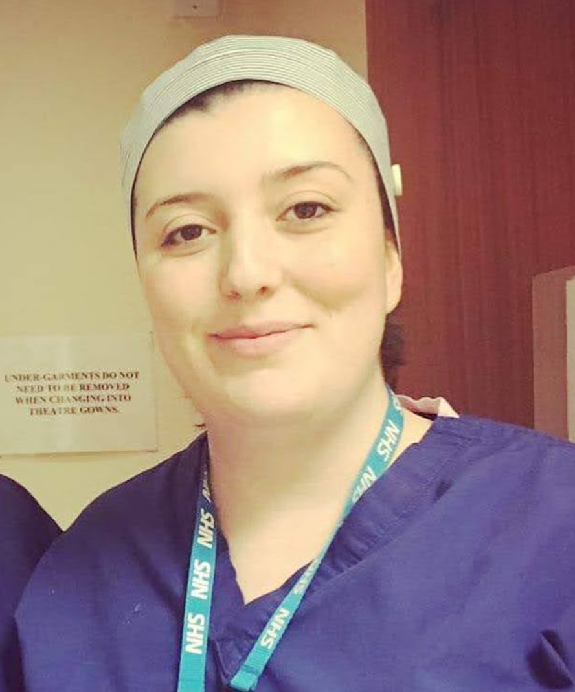
Operating Department Practitioner (ODP) Celebration Day
I was working for a letting agents when I first heard of the ODP role on a student forum, I applied the next day because I wanted to work in the theatre environment and it was important to me to be directly involved in patient care. I completed my degree in ODP at London Southbank University and worked at the Royal London Hospital before moving to Lancaster. Working at Day Case Theatres for Lancashire Teaching Hospitals Trust I have had the opportunity to work in a wide range of specialities.
My current role as an ODP is to care and advocate for all patients undergoing anaesthesia and ensure that the highest standards of safety are maintained at all times. I do this by maintaining cleanliness standards and appropriate stock levels at all times, I undertake daily maintenance and safety checking of all anaesthetic equipment and complete all relevant documentation in order to provide the best possible care. Post procedure I will care for my patient in recovery, watching for signs of nausea or pain until they are able to be safely returned to the ward.
What’s the best thing about being an ODP?
I personally find the role to be very fulfilling, especially in cases where you can see immediate results from the work that we have done and how patients lives are impacted. I particularly enjoy working in ophthalmology where patients often come in twice when having cataract surgery, when they return for the second procedure they sometimes tell us about how the sight they have regained after the first procedure has improved their quality of life and they can take part in their hobbies again.
Why become an ODP?
Operating department practice is a rewarding and ever expanding career that can provide you career progression opportunities not only in the theatres but in education, research, the resus team and many other areas. It allows you to care directly for patients and continuously obtain new knowledge and skills, working in many specialities within a multidisciplinary team.
Amber George, working in anaesthetics and recovery at Lancashire Teaching Hospitals Trust

