Slide 1
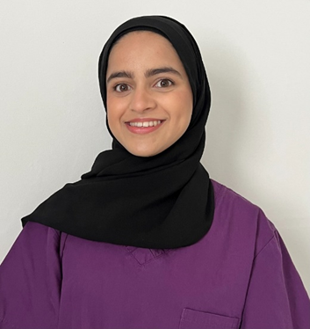
Orthoptic Celebration Day
I have always wanted to work in the medical field and explored a variety of careers. I shadowed an Orthoptist for a day and after some further research decided it was definitely something I would enjoy studying and eventually practicing.
I graduated from the University of Liverpool in 2020 amidst the COVID pandemic. Initially, I worked as a consenter/vaccinator at a mass vaccination site before finding part time work at Blackpool Teaching Hospital in September 2021. I approached the Head Orthoptist at Royal Preston Hospital who kindly agreed to allow me to work on a bank basis allowing me to gain invaluable experience.
I work in the hospital and community setting assessing paediatric and adult patients with a range of eye conditions including amblyopia (lazy eye), strabismus (squint) and other eye movement disorders.
What’s the best thing about being an Orthoptist?
How rewarding it is to be able to treat patients’ eyes and the variety of cases we see. No two days are the same!
Why become an Orthoptist?
There are plenty of opportunities to develop and you will always have the support you need.
Rukayya Nakhuda
Bank Orthoptist Lancashire Eye Centre
Lancashire Teaching Hospitals

Slide 2
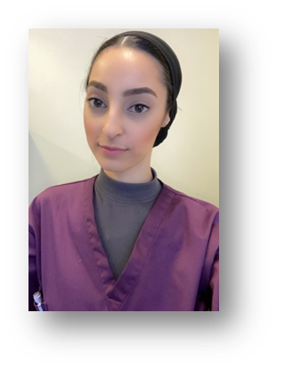
Orthoptic Celebration Day
My first interaction with an Orthoptist was when I attended an appointment to accompany my sister to have her eyes checked. I fell in love with the role there and then and aspired to pursue this as my career.
I graduated in 2019 from the University of Sheffield and began my Orthoptic career in 2020 at Birmingham Children’s hospital. I then joined Lancashire teaching hospital in 2022 to further develop my career.
Education Support: Working at a teaching hospital comes with great responsibility of training and teaching the future professionals. This is where my role comes in; I work alongside the lead clinical tutor to help aid timetables and resources for students attending our trust.
What’s the best thing about being an Orthoptist?
Fun Job, every day is different and rewarding in its own way.
To be a great Orthoptist in my opinion you have to work well as a team and be a keen and motivated individual to constantly learn and improve.
Why become an Orthoptist?
It’s a fun rewarding job with many specialities that you can specialise into. Every day is different so it doesn’t get repetitive or boring.
The degree allows you to explore and venture into different departments during your placements.
Rida Khalid
Specialist Orthoptist: Education Support
Lancashire Teaching Hospital

Slide 3
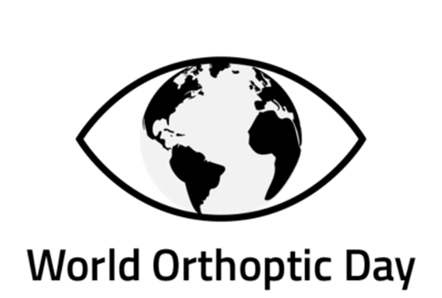
Orthoptic Celebration Day
I wanted to go into healthcare and orthoptics seemed interesting with the variety of different conditions people could present with. I graduated from the University of Liverpool in 2015 then worked in Lincolnshire for a couple of years. Since working at Lancashire Teaching Hospitals I have learnt many new skills and gained specialist knowledge in my specialist area.
In my current role I investigate, diagnose and manage ocular motility (eye movement) problems and manage vision problems in young children. I also specialise in glaucoma, assessing and managing patients within that sub-sect of ophthalmology.
What’s the best thing about being an Orthoptist?
The wide range of patients seen, including a range of complex cases. You get to meet people from many different walks of life and be a part of their treatment.
Orthoptists have a wide range of knowledge and there is always scope to learn more. We work alone as well as within a multi-disciplinary team in ophthalmology, allowing the best care for our patients.
Why become an Orthoptist?
People are very grateful for the care you give which makes you feel like you are doing something effective and helpful.
Nabila Shaikh
Specialist Orthoptist Lancashire Eye Centre
Lancashire Teaching Hospitals

Slide 4
Orthoptic Celebration Day
I came to the profession later than usual in my early 30s. I had previously completed a degree in Psychology and was working in an administrative role for many years. I decided to retrain as an Orthoptist as I had a keen interest in how our bodies work and wanted a job which used this information to assist others.
I graduated from Liverpool university in 2019 and gained my first role as an Orthoptist at Blackpool Teaching Hospitals in September 2019. This was a dual role as an Orthoptist and assisting on the medical retinal unit. I commenced employment at Lancashire Teaching Hospitals in February 2020 (just before Covid!) and started my PhD in health services research in December 2020. My PhD research involves the investigation of perimetry practice in neuro-ophthalmology and normative visual field assessment in children. My research is fully-funded by the University of Liverpool and Haag-Streit AG which allows me to complete the research activities during my working day.
My current role involves many research-based activities at the University of Liverpool and across two NHS sites (Lancashire and Salford). Research activities include completing literature reviews, administration and implementation of two NHS research studies and attending conferences/ giving presentations of my findings. As a research Orthoptist, you really are your own ‘manager’, planning your own daily activities, creating your own research clinics and proactively recruiting for your own studies. This gives flexibility, however, can be challenging at times!
I also work a clinic day a week in which I see paediatric and adult patients in an Orthoptic clinic.
What’s the best thing about being an Orthoptist?
No two days are the same! I can be assessing a premature baby’s visual development in the morning and be prescribing prisms to a 101 year old, so she can continue to do the hobbies she loves in the afternoon.
I love that as Orthoptists, we can use the scientific knowledge we have attained to help people and really make a difference to people’s lives. This may be helping to improve vision in a child with amblyopia, prescribing prisms to an adult with double vision so they can continue to drive or completing research to further evidence-based practice.
There are many diverse roles Orthoptists can now specialise in which really makes our role within Ophthalmology versatile and ever-changing. I work in a team of Orthoptists who all have various areas of expertise, such as Glaucoma, Stroke, SEN, visual processing disorders, neuro-ophthalmology, low vision and teaching. This makes it an exciting place to work as our multi-faceted skills benefit our patients in so many different ways.
Why become an Orthoptist?
So many reasons! Being an Orthoptist makes you think every day, involves communicating with a wide range of people and can be mentally challenging at times. However, it is ultimately rewarding as you see the impact your work has directly on patient’s lives.
Michaela Sherlock
Orthoptist and second year PhD Candidate, Lancashire Teaching Hospitals
Salford Royal NHS Foundation Trust (Research)

Slide 5
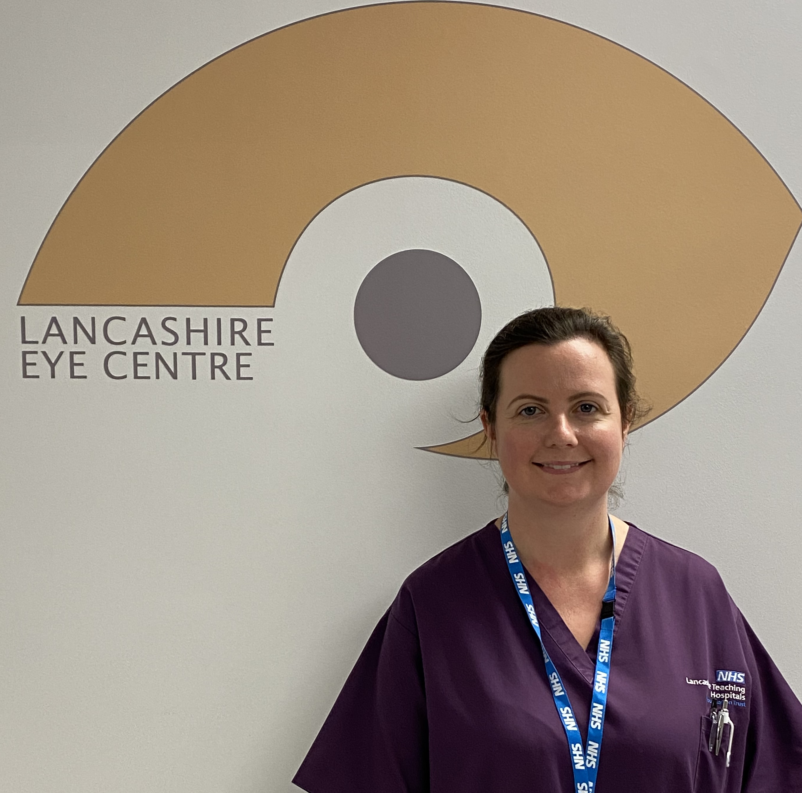
Orthoptic Celebration Day
I wanted to work in healthcare helping people didn’t know in which capacity until I came across the Orthoptics degree course purely by chance. I shadowed an Orthoptist for the day and loved it immediately.
I graduated from the University of Liverpool in 2007. My first post was in Northern Ireland before taking a post at Bolton Royal Infirmary and then moving to Lancashire Teaching Hospitals Trust in 2014. I have always enjoyed teaching and moved into this post specifically to lead on that part of the Orthoptic service.
I am an experienced Orthoptist who works in the complex ocular motility clinics in addition to general Orthoptics. As Lead Clinical Tutor I am responsible to co-ordinate undergraduate Orthoptists work placements, facilitate their learning and undertake their evaluations. I also co-ordinate Orthoptic experience for other disciplines including Medical and Optometry Students. I also have close links with the University of Liverpool, University of Sheffield and University of Central Lancashire and have provided guest lectures/tutorials to their students.
What’s the best thing about being an Orthoptist?
I love the variety of my day. Every patient is an individual that we tailor our assessments and treatment to. Facilitating learning for students is very rewarding and essential to maintaining future workforce for the NHS as is promotion of the profession. I like that in our trust I have been given opportunity for further development. We have a dynamic department which always strives for excellence and keeps up-to-date with advances in treatment.
Why become an Orthoptist?
If you want a job that makes a notable difference to peoples lives, that is ever developing and has a lot of scope for continued professional development Orthoptics is one to research.
Hannah Harwood
Advanced Orthoptist and Lead Clinical Tutor at
Lancashire Teaching Hospitals Trust

Slide 6
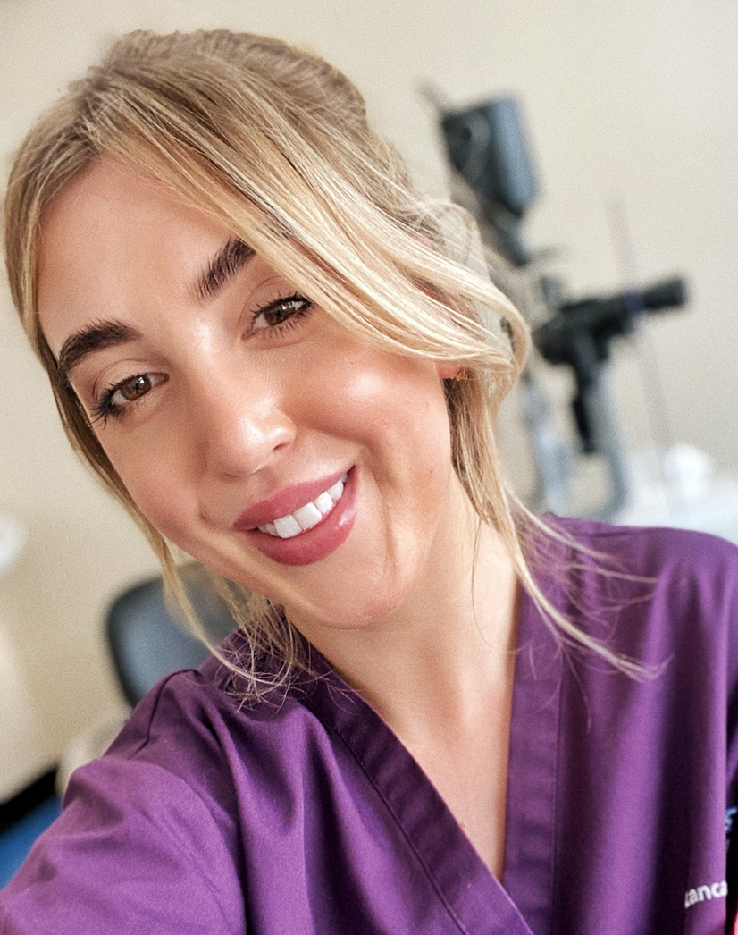
Orthoptic Celebration Day
I wanted to work in the healthcare sphere, but medicine wasn’t for me, I liked the complexity and variety that orthoptics offered in terms of caseload. I also loved that we got to see a good mixture of adults and children!
I graduated in 2015 and began my first job immediately after at QMC, Nottingham where I stayed for 7 months. I knew I wanted to gravitate back to the Northwest and decided to take the risk on a 12-month maternity cover post at Royal Preston Hospital. I’d been here on placement as an undergraduate and really enjoyed my time. I applied and interviewed for a substantive role after 12 months and not only was I successful, but this will be my 7th year here...time flies! I began to take on extra roles such as teaching and completed my tutor’s course in 2017, following this I became involved in glaucoma and neonatal ROP screening which I have been doing for 4 years. Most recently, I’ve been accepted to study on a master’s programme at the University of Sheffield. This is Ophthalmology Advanced Clinical Practice (paediatrics) and will mean I can have a greater role within paediatric ophthalmology as an ACP. I am very excited for the future 😊
As a band 6 Orthoptist I cover a range of paediatric and adult orthoptic clinics, as well as supporting consultant clinics such as neuro-ophthalmology and glaucoma diagnostic clinics. My special interest is paediatric ophthalmology where I work alongside our paediatric consultant this role will evolve more as I take on the Ophthalmology Advanced Clinical Practice Masters’ programme which begins in September this year. I also support the ROP neonatal screening which means I attend the NICU weekly to perform imaging procedures on these little ones! As a teaching hospital we often have Orthoptic undergraduates, junior doctors or optometrists so clinical teaching is also a big part of my role.
What’s the best thing about being an Orthoptist?
The best thing about being an Orthoptist is the scope of clinical practice. The future is so exciting for Orthoptists we have such great core skills that are transferable to SO many areas of ophthalmology.
You can really find something that suits you and run with it!
Why become an Orthoptist?
It’s such a unique AHP role and we’re all lovely if not a bit crazy!
Bridie Bukorovic
Band 6 Specialist Orthoptist, Lancashire Teaching Hospitals

Slide 7
Orthoptic Celebration Day
I met someone with an interesting eye condition whilst at university reading a different subject and ended up studying Orthoptics.
After qualifying and settling into clinical practice I soon became head of department for many years, then went back to a clinical role which has allowed me to work in many speciality areas and currently within stroke and acquired brain injury.
I am the lead Orthoptist for stroke and acquired brain injury. This is a fascinating sub-speciality requiring clinical skill and knowledge alongside an understanding of the impact of visual loss on daily life. Communication skills are a key factor for both assessment and liaison with the multi-disciplinary team to achieve the best individual outcome.
What’s the best thing about being an Orthoptist?
Orthoptics offers opportunities to work across the age spectrum, and autonomously in many specialist areas, alongside consultants and the wider multidisciplinary clinical teams. Orthoptists have highly specialist knowledge which contributes to effective patient care and management.
Why become an Orthoptist?
Orthoptics is an expanding profession with opportunities for long-term personal development in clinical, educational and management roles for individuals seeking a career in patient care.
Angela Costello
Lead Orthoptist for stroke and acquired brain injury
Lancashire Teaching Hospitals

Slide 8
Orthoptic Celebration Day
I met someone with an interesting eye condition whilst at university reading a different subject and ended up studying Orthoptics.
After qualifying and settling into clinical practice I soon became head of department for many years, then went back to a clinical role which has allowed me to work in many speciality areas and currently within stroke and acquired brain injury.
I am the lead Orthoptist for stroke and acquired brain injury. This is a fascinating sub-speciality requiring clinical skill and knowledge alongside an understanding of the impact of visual loss on daily life. Communication skills are a key factor for both assessment and liaison with the multi-disciplinary team to achieve the best individual outcome.
What’s the best thing about being an Orthoptist?
Orthoptics offers opportunities to work across the age spectrum, and autonomously in many specialist areas, alongside consultants and the wider multidisciplinary clinical teams. Orthoptists have highly specialist knowledge which contributes to effective patient care and management.
Why become an Orthoptist?
Orthoptics is an expanding profession with opportunities for long-term personal development in clinical, educational and management roles for individuals seeking a career in patient care.
Angela Costello
Lead Orthoptist for stroke and acquired brain injury
Lancashire Teaching Hospitals

