Slide 1
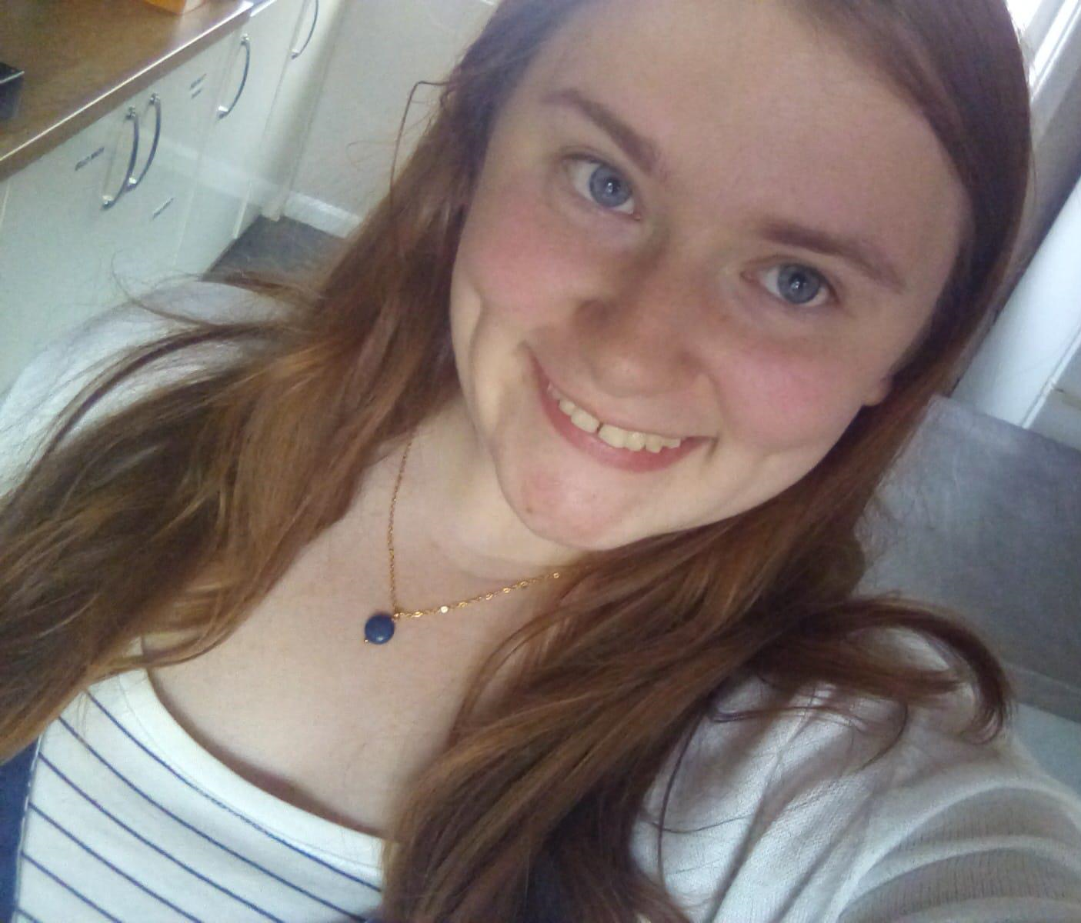
Prosthetists and Orthotists Celebration Day
I chose Orthotics as I believe independence is of the utmost importance when ensuring that someone has dignity and a good quality of life. Mobility is a very big part of independence and being able to help aid in this is very rewarding.
I did a BTEC in Applied science and then went on to do a BSc Hons degree in Prosthetics and Orthotics at the University of Salford. As of P and O day I will have been an Orthotist for 3 months.
Each day I see a variety of people, these can be from 4 weeks old to 114 years old. I help to give braces to people which influence their biomechanics. Everything from helmets to insoles. Head to toe.
What’s the best thing about being an Orthotist?
Being in a busy and fast paced environment.
Being able to restore mobility, and independence and often give people hope.
Why become an Orthotist?
To help people regain independence and mobility. To improve patients' quality of life.
Danielle Whittaker
Orthotist
East Lancashire Hospital Trusts

Slide 2
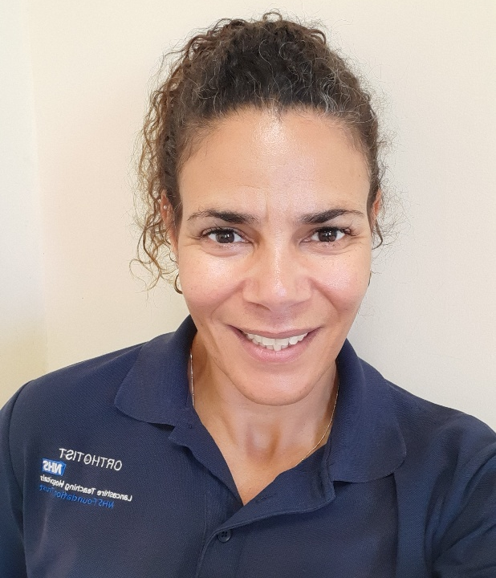
Prosthetists and Orthotists Celebration Day
I chose to become an Orthotist as I wanted to make a genuine difference in peoples’ lives.
When I left school I joined the Royal Airforce as an Aircraft Electrical Mechanic but in my mid 20s I started to think that I would prefer to work with people rather than inanimate objects. The problem was that few careers in that field seemed to suit my mechanical mind. I was introduced to Prosthetics and Orthotics at a Careers Open Day at Salford University and it seemed to fit the bill perfectly.
I work with clients of all ages and prescribe devices that are externally worn which, correct, retard or support physical deformities and weakness. This ranges from Functional Foot Orthoses (which alter the interaction of the foot with the ground) to Spinal Orthoses (which slow progressive conditions, support weakness or limit the motion of fractures). The work is varied and interesting.
What’s the best thing about being an Orthotist?
The best thing about being an Orthotist is the satisfaction when we achieve our objective. It is great to be a part of improving the comfort and function of a varied portion of the population.
Why become an Orthotist?
If you have an understanding of mechanics but want the satisfaction of a caring profession this is the career to consider.
Jan Okunowo
Senior Orthotist
Specialist Mobility and Rehabilitation Centre, Preston.

Slide 3
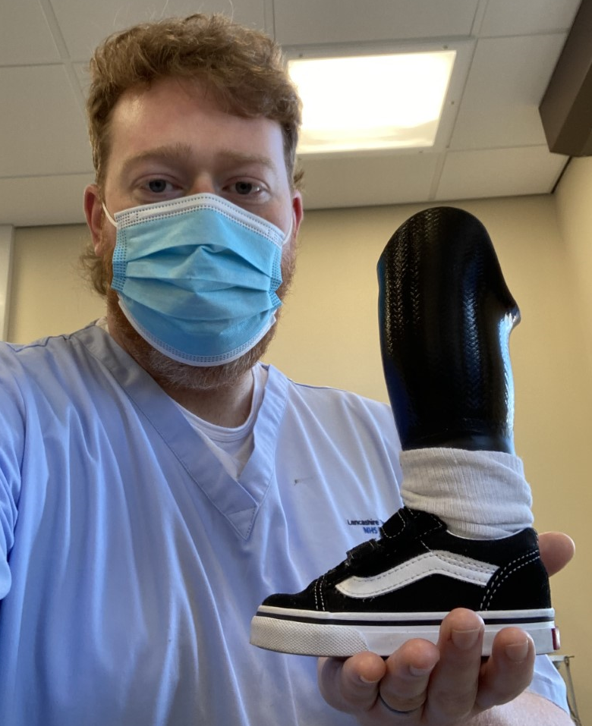
Prosthetists and Orthotists Celebration Day
I decided whilst at school that the 3 main criteria I would be looking for in a prospective career were that I did not want to sit behind a desk all day, I did not want to wear a shirt, tie, and suit and I wanted to work helping people in some medical field. I researched different careers within the NHS and narrowed it down to Physiotherapy or Prosthetic/Orthotics. My guidance teacher recommended Prosthetics and Orthotics as following meetings at school she knew I was mechanically minded and liked to use my hand skills and interpersonal skills to help people.
I attended the NCPO (National Centre for Prosthetics and Orthotics) at Strathclyde University, graduating with a BSc (Hons) degree in Prosthetics and Orthotics in 2004. I have worked as a Prosthetist since then. I have worked in rehabilitation centres across the UK, including Leeds and Edinburgh and now work in Preston as a Senior Prosthetist
My current role as a Senior Prosthetist involves treating amputees and prescribing upper and lower limbs to replace functional loss. The prosthetist’s role is to liaise with all the members of the multi-disciplinary team, including Rehabilitation Consultant and decide on a treatment plan to attempt to restore the patient’s functional loss following amputation. The Prosthetist takes an impression of the patient’s residual limb, either by casting or scanning, adjusting the model and prescribing the appropriate components/devices to enable the patient to return to their daily activities as much as possible. The limb is manufactured by Prosthetic Technicians to the appropriate prescription and then fitted to the patient by the Prosthetists. The limb/device is then adjusted to its optimal settings to allow the patient to maximise the utilisation of the prosthesis, ensuring the patient is pleased with the outcome.
What’s the best thing about being a Prosthetist?
As a Prosthetist there is a tremendous amount of job satisfaction. Utilising your skills allows a patient to walk again, potentially gaining independence again or participating in a new activity or sport giving the patient a huge feeling of well-being or fulfilment.
Unlike many AHP disciplines, Prosthetic patients require continual care throughout their lives, which allows long term relationships to be made, which benefits both parties.
As new technology is being developed, the types of sockets, and choice of componentry adapts, so improvements to patient’s lifestyles and well being is constantly developing. Many of the standard prescriptions now weren’t available when I began my career, and this continual improvement helps keep things interesting.
I enjoy working with children and complex patients, as these more challenging cases allow you to be more creative and use more lateral thinking to achieve a positive outcome.
Paul Leishman
Senior Prosthetist,
Specialist Mobility and Rehabilitation Centre (SMRC), Preston.
Why become a Prosthetist?
If you are interested in helping people and making a positive difference to people’s lives, blending medical and engineering principles, then this is the best career for you.

