Slide 1


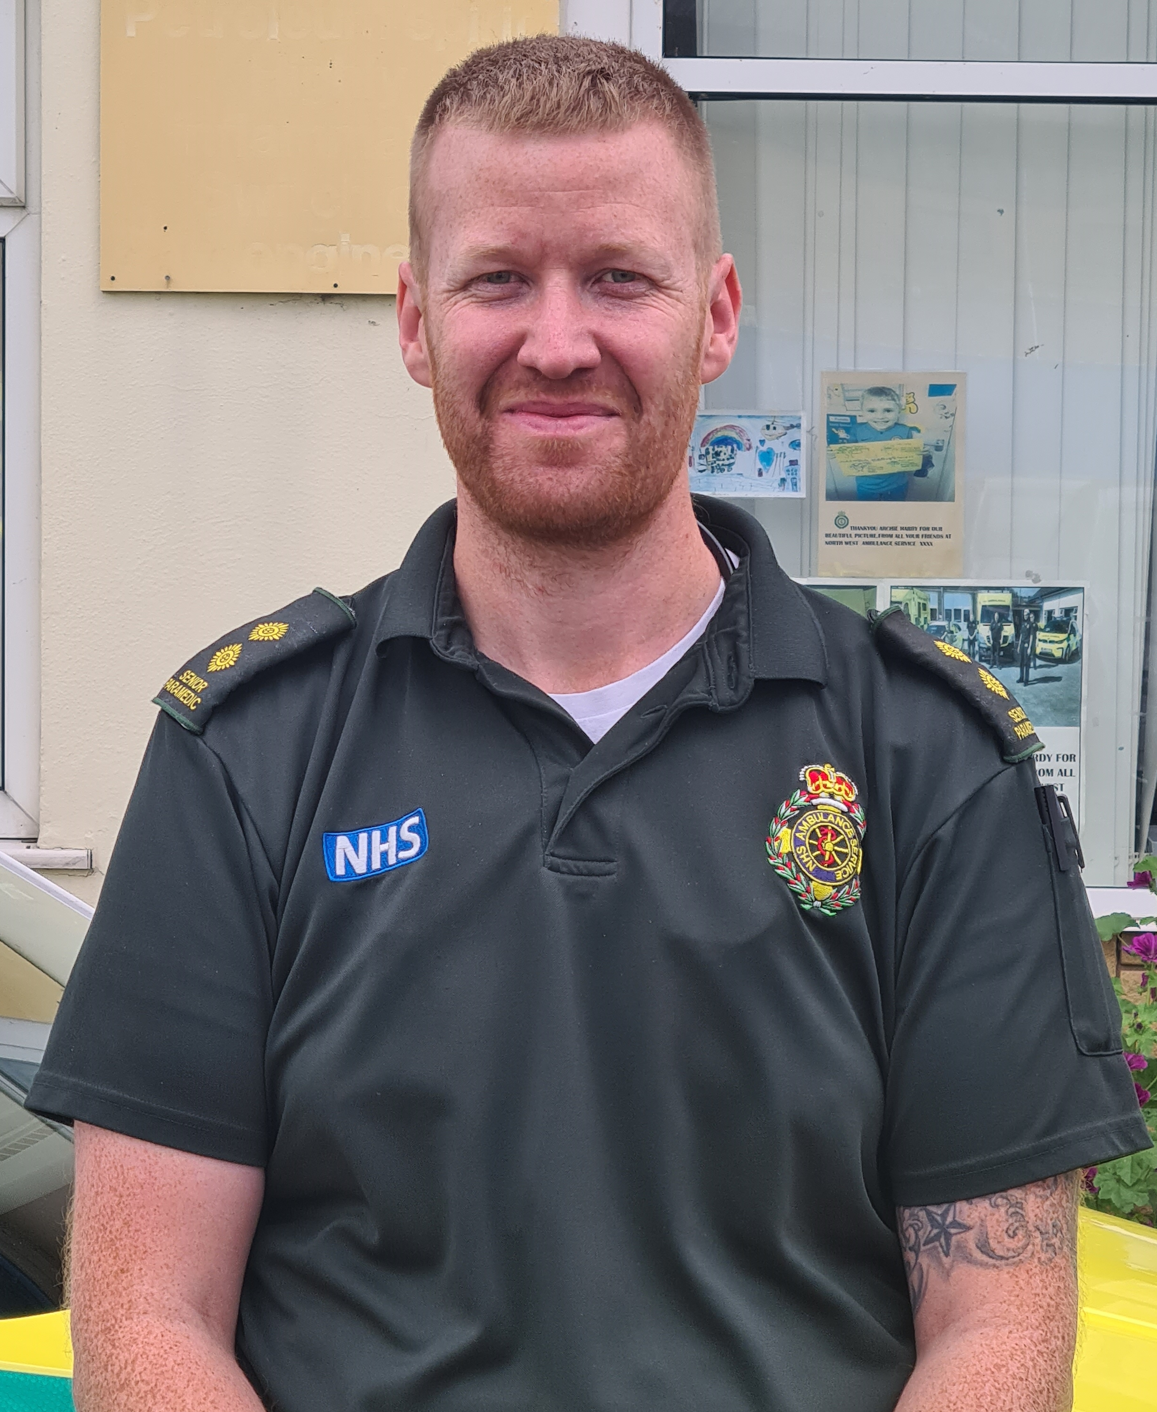
Paramedic Testimony
I was working as retail management and decided that I wanted to do something more meaningful than just making people money.
I left my job in retail in 2014, I was a stay at home Dad for a year whilst doing an access to higher education diploma and
re-doing some GCSEs. I started at UCLan in 2015 on a Paramedic Practice DipHE and graduated in 2017. I started with NWAS and completed the Newly Qualified Paramedic program. In 2019 I started an Senior paramedic team leader (SPTL) development program and became an SPTL a few months later.
I attend clinically complex incidents to provide immediate care to critical unwell or injuries patients. I lead a team of Paramedics and Emergency Medical Technician’s (EMTs), caring for their welfare and ensuring standards. I provide operational management for the sector to ensure the best patient outcomes.
What’s the best thing about being an Paramedic?
The role is varied and complex, with no two days ever being the same.
The people! We’re a strange mix of individuals who donn the uniform and become a team. We call it our green family. We are all unique in our approach to the job, but with a singular focus on helping people who need us. It comes with a great amount of pride.
Why become an Paramedic?
Being an SPTL means that you can make life better for those who you lead. This means that they are better equipped to help those who call on the ambulance service for help.
Peter McKinlay
Senior Paramedic Team Leader (SPTL), East Lancs

Slide 2
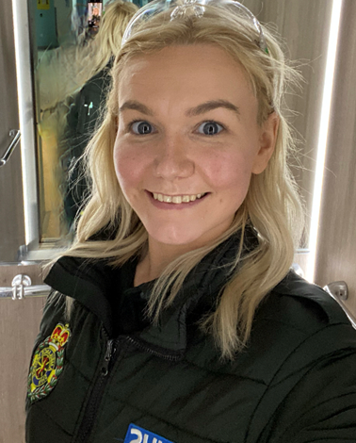
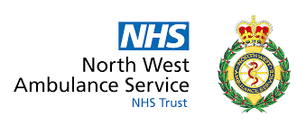
Paramedic Testimony
I previously worked at 111 for 5 years and wanted a new challenge. That combined with wanting to know more about what happened after I sent details over to the ambulance this seemed like the perfect job.
When I start my technician training, I did 13weeks clinical training which involved learning about different conditions, treatments and how to manage certain conditions. I then did 4 weeks blue light driving. Once I had completed this training, I then had to complete a portfolio to show I was competent in my role on the road. This involved providing evidence that I could do certain skills, .e.g. ECG’s on patients or providing reflections on incidents I had attended. Once I had finished this I gained an Associate Ambulance Practitioner (AAP) qualification. 2 years after completing this I then became eligible to apply for the Student Paramedic Apprenticeship within my trust. This is a 2-year degree (as my AAP qualification counts for the first year) to become a paramedic. I have to attend university approx. 40 days a year whilst working full time on the road. I will also complete essays, practical exams and dissertation during this course. In October 2023 I will qualify as paramedic.
I’m currently an Emergency Medical Technician 1 (EMT) on a Student Paramedic apprenticeship. This means when I am working on the road with fellow paramedics, I can practice certain paramedic skills as part of my degree. I have spent the past 4.5 years as an EMT1 and will complete my first academic year at university in September. I currently work full time whilst attending university 40 days of the year. I attend all nature of jobs whilst working on the road. From GP admissions to life threatening injuries or cardiac arrests.
What’s the best thing about being an Paramedic?
Learning, as someone that constantly loves to learn something new this job fulfils that. You think you’ve seen a patient present with a condition the same way hundreds of times then something new appears and then it gets you going down this rabbit hole – well it does me – into why this has happened.
Then there’s the other people you work with. I’ve developed a proper second family at work with people that understand how just how difficult the job can be at times. I’m lucky work with supportive friends.
Why become an Paramedic?
If you want to be a paramedic to constantly save lives then this isn’t the job for you, as we don’t always go to life threatening incidents. However, if you want a job that gives you an opportunity to make a difference to someone’s life by just being there and listening to them, this is it.
Jessica Baird
EMT1/Student Paramedic, East Lancashire/ Blackburn

Slide 3
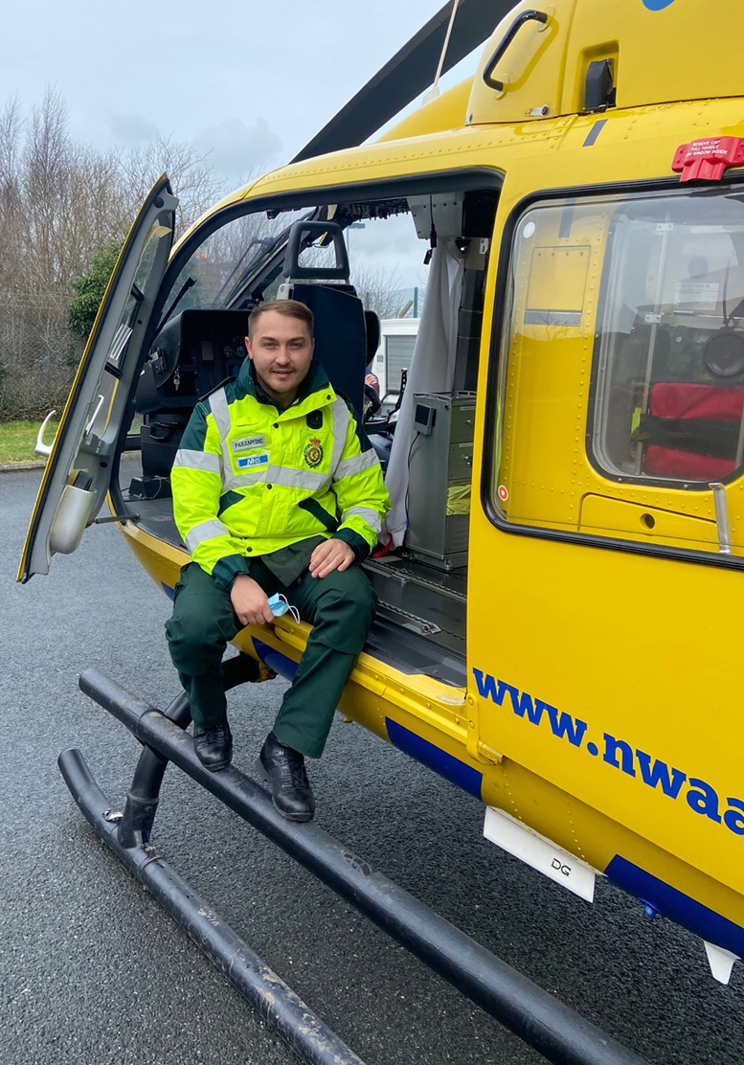
Paramedic Testimony
I’ve chosen to pursue a career within the prehospital profession because I believe it suits my individual personality traits. It’s an intriguing and exciting profession, that can split several different emotions over a period of 12 hours. The contrasting experiences combined with autonomous decision making solidified my ambition to become a paramedic.
I left full time employment to pursue a career as a paramedic. On leaving previous employment, I needed to attend an access to health and social care course, thus allowing me to apply for university the following year. The paramedic course itself is three years long. I completed this at the end of the academic year of 2021, totalling 4 years to become qualified as a paramedic. I’m currently in my newly qualified stage (NQP), with just over 12 months experience gained. I’m currently looking to fast track my NQP period as I feel comfortable enough to do so. Moving forward, I wish to apply to start an MSc in advanced clinical practice, and maybe in the far future apply for a position with HEMS.
Paramedics are traditionally prehospital emergency care providers. However, due to fairly recent changes that have enhanced the scope of practice, encompassed with the underpinning theoretical understanding, paramedics have now expanded in to primary care and other multidisciplinary NHS providers. My personal role is one of a more traditional nature. I respond to 999 and 111 calls. Gather history, perform a clinical examination, put together differential diagnosis/impressions, work with patients, relatives and other multidisciplinary teams to formulate a treatment plan. Patient’s can present with a multitude of complaints. For example, mental health presentations, end of life care, births, cardiac arrests, chest infections etc. Patient’s may also be referred to alternative services, rather than transported to hospital. Due to the increased pressure of the ambulance services, alternative or own transport to hospital may be asked of by paramedics, if safe to do so.
What’s the best thing about being an Paramedic?
The best thing about our profession is the exciting nature of the role. Not only do we respond on blue lights, but we get to see the most amazing and wonderful things. Being part of a team and having that autonomy to formulate plans is a great strength for the paramedic profession.
Why become an Paramedic?
If you feel you have the ability to keep calm under extreme pressure, enjoy working within a team, yet still retain that autonomous working environment then consider the paramedic profession. Furthermore,
the exciting nature, complexity, challenging and privileged career is arguably the most
rewarding and practical that the NHS has to offer.
Cain Catlow
Paramedic, Blackburn Ambulance Station.

Slide 4
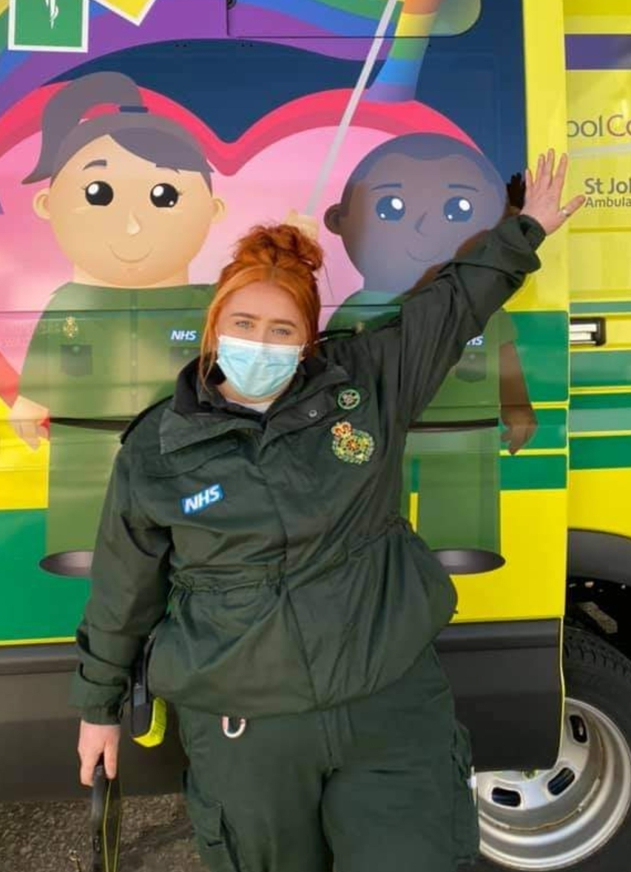
Paramedic Testimony
I chose this profession as I wanted an occupation that would bring me job satisfaction while helping people in a medical capacity.
I was working as a mental health support worker at the time within mental health units when I assisted in a life-threatening incident. I found that I felt calm throughout and I was very interested in what the ambulance crew were doing and I wanted to know more about the role. After speaking to the crew about what their typical day looks like and what training was required, I made the decision to return to university to become a Paramedic.
I currently work on ambulance attending emergency incidents that are both clinical and social in nature. I work alongside other paramedics or EMT’s as part of a two-person crew providing emergency pre hospital care to patients.
What’s the best thing about being an Paramedic?
As a paramedic, you are present at all stages of people lives. This is massive privilege and making a positive difference in those moments, from beginning to end and everything
in-between, is very rewarding and makes this profession great.
Why become an Paramedic?
You should become a paramedic because no two days are the same.
Amy Oliver
Paramedic, North West Ambulance Service

