Slide 1
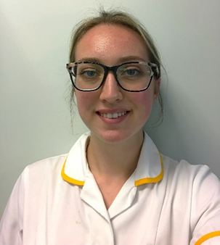
Podiatrist Celebration Day
I wanted a career in health care and podiatry really appealed to me, I wanted a rewarding role working with people, there are many specialist areas in podiatry which I found interesting.
I qualified in May 2022 so I am still learning a lot now I have begun my band 5 position. Where I undertake assessments of the foot and ankle, anything from nail conditions to skin conditions, to wounds or biomechanical problems. I complete busy clinics in health centres and visit people in their homes if house bound. I complete nail surgery on Thursdays.
What’s the best thing about being an Podiatrist?
It is a great career because you are very hands on and practical, helping people daily and seeing improvements in patients conditions each week. It is a flexible role with no weekends so it works well around your personal life, there are many different areas you can specialise in depending on your interests
Why become an Podiatrist ?
It is very rewarding and I enjoy meeting new people,
the team I work in is like a family we all support one another.
Shona Wesley
Podiatrist, Rossendale Community

Slide 2
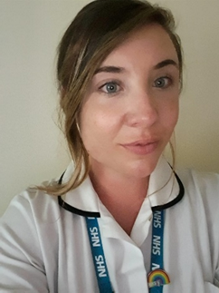
Podiatrist Celebration Day
I was deciding between becoming a paramedic, nurse or podiatrist and was lucky enough to do some shadowing. I fell in love with podiatry and the specialism surrounding and knew it was for me.
I graduated in 2018 from the University of Huddersfield and then obtained masters modules in: Tissue Viability and offloading, person centred care, holistic assessments, steroid injection therapy and forensic podiatry. I had my first interview at Darwen Health Centre and was lucky enough to be offered the job, so have been with LSCFT since I graduated. I obtained my specialism in 2019 and have since become Team Leader in 2021.
I work in the community setting attending urgent referrals for wound care to the feet. This can include diabetic foot ulcers, pressure ulcers, surgical wounds, burns and much more. We see conditions such as diabetes and rheumatoid arthritis and work with how these changes can affect the feet and prevention of high risk changes. I also work in the foot ulcer clinic at Minerva, providing debridement and offloading. As well as this, I do general assessments including biomechanical assessments and insole advice and nail surgery for problem nails as well as an ABPI for referrals into vascular. I see a lot of shared care patients with Treatment Room Nurses and District Nurses providing a full care overview for best patient outcome.
What’s the best thing about being an Podiatrist?
The best thing about being a podiatrist is the specialism and niche area of expertise. We have such a unique skill set and knowledge base of all conditions that affect the feet that we really are leading when it comes to the foot and lower limb. As a podiatrist you will find someone to help and someone who needs your service everywhere, from hospital wards to nursing homes to peoples own homes the possibilities of where this profession can lead you are endless. As well as that, I believe you have to be passionate about the job to work solely with feet and the limbs, so you will find your colleagues have the same passion to achieve an overall goal for the patient.
Why become an Podiatrist?
You should consider a career in Podiatry if you wish to obtain an area of specialised care where you can really help patients and change lives. The work life balance is fantastic and it really can lead to exciting roles ie; working with vascular, in hospital settings, community, within A&E’s or private care. It’s still a profession being developed but with endless possibilities. Podiatry is really saving limbs and saving lives which is so very rewarding.
Hannah Westwood
Specialist Podiatrist and the Preston Team Leader and work in Central Preston covering clinics and home visiting in the community.

