Slide 1
Radiography Celebration Day
I wanted a change in my career pathway and wanted to better myself. So I decided to follow my ambition to become a radiographer
I trained at Bradford Royal Infirmary and worked in an Xray department for 20 years and 7 years ago a vacancy came up in the angiogram team and I decided to move across and I have been there ever since.
I screen vascular patients who are having treatment to improve circulation from having narrowed/blocked arteries and screening patient who need to have lines, stents inserted.
What’s the best thing about being an Radiographer?
Everyday is different, meet lots of people from all walks of life. Making an improvement to someone's lift.
Why become an Radiographer?
It’s a great career, well respected and good career prospects
Sherly Walsh
Interventional Radiographer

Slide 2
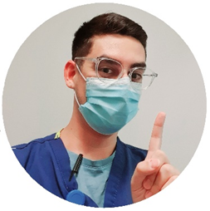
Radiography Celebration Day
I was good at physics in college but always wanted to help people. After a short stint trying to do physics, a friend recommended me to Radiography which seemed like the best way to apply my talents to help people and work in the NHS.
I worked in plain film (x-rays) for a little while and quickly went onto work night shifts with a great team. I applied for a job in CT which I worked in for around a year before moving into a split post in CT and Interventional Radiography. I now work full time for the Interventional department and really enjoy it.
My current role is as an Interventional Radiographer. I assist Consultant Interventional Radiologists in screening for procedures that treat vascular problems via an endovascular approach. We also perform liver cancer treatment, insert nephrostomy tubes into the kidney, assist in vascular theatres, perform biliary drainages/stentings and more.
What’s the best thing about being an Radiographer?
The best thing about being a radiographer is the varied work you can do. There are so many areas that you can work in and you will as a radiographer be a part of nearly every patient’s journey through the hospital.
Radiographers stick together and often form a united front. We are also in a very fast-moving profession and therefore stick to the ethos of evidence-based practice. This means that there is always something to learn and new things to do.
Why become an Radiographer?
If you enjoy working with technology and patients, you should become
a radiographer. Our career paths are always evolving and we are quickly
becoming more specialised with reporting, consultant and practitioner
radiographers.
Sarm Falaki
Interventional Radiographer

Slide 3
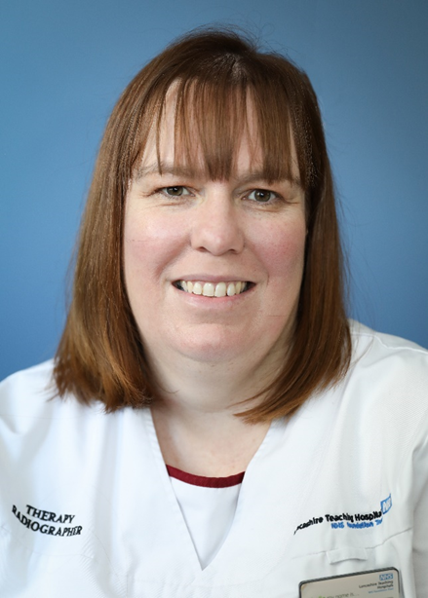
Radiography Celebration Day
I wanted to become a Radiographer to work in a role which involved caring for others which also involved science.
I qualified in 1999 from Queen Margaret University and started work at Lancashire Teaching Hospitals as a Therapeutic Radiographer. I have continued to work her for 23 years progressing through many different roles, from treatment delivery, education and finally into management.
I currently lead the Radiotherapy team at Lancashire Teaching Hospitals ensuring the service provides consistently high care for all patients in Lancashire and South Cumbria
What’s the best thing about being an Radiographer?
I get to help patients every day while also working within an amazing team.
Why become an Radiographer?
Therapeutic Radiographers make a difference to patients along their cancer journey and is one of the most innovative roles in the NHS.
Gillian Clarkson
Radiotherapy Service Manager

Slide 4
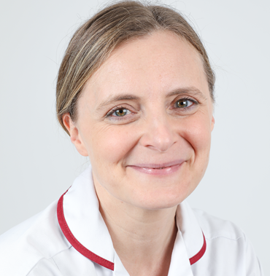
Return to Practice Profile
Dr Lisa Ashmore completed the Return to Practice HCPC process and has now been appointed as the first clinical academic therapeutic radiographer in the radiotherapy department at Rosemere Cancer Centre, Preston. Here is Lisa’s summary of the process:
Using the HCPC standards of proficiency I created a list of topics I needed to cover and a spreadsheet on which to record and keep track of progress against the total number of days required.
In total I completed nine days of formal study related to radiotherapy practice. These included communication skills related to cancer, LGBTQ+ healthcare, living with and beyond cancer, radiotherapy planning updates, breast irradiation updates, IR(ME)R updates .Seession were delivered by various organisations including Cancer Research UK; Royal Society of Medicine; Royal College of Physicians; Christie School of Oncology; and Royal College of Radiologists.
Having mapped all the study sessions to the standards of proficiency, I was able to identify key gaps for focus and working with the Radiotherapy Practice Educator, I was supported to work towards signing off clinical competencies. This also prompted more learning objectives for self-study.
Meanwhile, I was aware that the Society of Radiographers had published the guidance on Clinical Academic Radiographer Roles in September 2021 and the Allied Health Professionals Research and Innovation Strategy released in Jan 2022 which also described routes for Clinical Academic AHPs, career structures that weren’t in place when I completed my PhD in 2011. Working
with the Chief and Deputy Chief AHPs and the Head of Radiotherapy Services, funding was secured from the
Lancashire and South Cumbria Cancer Alliance to develop a 12 month secondment opportunity for a Clinical
Academic Therapeutic Radiographer, which I was thrilled to be appointed to in September this year. This role
enables me to continue with my academic work at Lancaster University and also help support research activity
in the department. I continue to do some Band 5 bank work to maintain my clinical competencies.
For further details of her story please use the link below
https://www.sor.org/news/people/dr-lisa-ashmore-appointed-to-clinical-academic-rol
Dr Lisa Ashmore
Clinical Academic Therapeutic Radiographer

Slide 5
Radiography Celebration Day
I became a Radiographer because I completed a Kudos questionnaire and the best job based on my answers was a Radiographer.
Started as a Band 5 in x-ray, rotated into Interventional Radiographer and then applied for Band 6 in Interventional Radiographer, I gained knowledge and experience in this area then applied for clinical lead post and was successful. I manage the Interventional Radiographer service – ordering stock, rotas, recruitment, sickness meetings etc
What’s the best thing about being an Radiographer?
Feeling like you make a difference, expedite patients who are clinically urgent and brainstorming ideas on how to improve the service offered to patients in East Lancashire and opportunities for staff to develop their skills.
Why become an Radiographer?
Make a difference to the future of the NHS.
Excellent career choice with lots of opportunities for progression and development.
Beverley Lowe
Lead Interventional Radiographer

