Slide 1
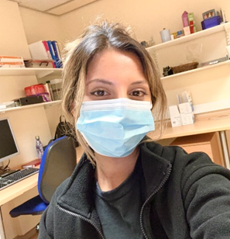
Speech and Language Therapy
My name is Sakhina. I am a Speech and Language Therapist (SLT) working across the stroke pathway. At present, I am based on the Marsden Unit. I assess and treat patients with a range of communication and swallowing difficulties. Working as a SLT allows me to improve the care and lives of my patients.
I graduated with a degree in Speech and Language Therapy in 2020. I have had experience working in acute, stroke and neurorehabilitation. I have gained a varied set of skills which I am now applying and specialising within my role in stroke.
My first rotation is on a stroke rehabilitation ward. I work alongside a multi-disciplinary team with adults post stroke. My role involves assessment and rehabilitation of patients who present with communication and swallowing difficulties.
What’s the best thing about your role?
The best thing about being a SLT is the opportunity to make a difference to a person’s life. I strongly believe that communication and eating/drinking are 2 fundamentals in life and working as a SLT plays a pivotal role which is rewarding.
Why should someone want to work in this role?
Working as a SLT has many benefits. It is a varied career with a great degree of flexibility. SLT’s work with a diverse range of patients and families to help maximise the quality of an individual’s life. A profession with life-long learning and ongoing opportunities to contribute to fundamental research.
Sakhina Patel
Speech and Language Therapist

Slide 2
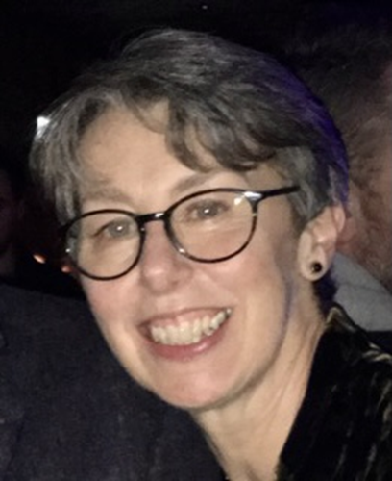
Speech and Language Therapy
I wanted to complete a vocational degree and a careers advisor gave me a questionnaire to match skills with professions. I had spent some time with an Speech and Language Therapist (SLT) during a volunteer programme and was pleased when SLT came up on my “matched” list.
I graduated from Reading University in 1987 and then went to work in Portsmouth. This was a post where I treated adults in an acute hospital and children. My interest was always aphasia and adult treatment and I moved on to work in Oxford with an adult caseload on their neurosciences unit. Later I wanted to return to the north of England to be nearer my family and moved to the neurosciences unit in Preston. When I had children, I moved to a job in East Lancashire where I was closer to home and initially worked part time. I have returned to full time hours. I work with people with aphasia which still fascinates me and have been supported to complete a masters as well as leadership qualifications during my time in East Lancashire.
People come to our unit when they have had a brain injury or illness. These injuries can affect talking, swallowing, walking, thinking skills etc and some of the people we treat have got many difficulties including challenging behaviour. I work with a team of colleagues to help people on our caseload become more independent with an improved quality of life, trying to return home to live with their families and take part in activities and roles that are meaningful to them. I see a small caseload, completing treatment sessions every day. I have to plan therapy that will help people progress in small stages. I spend time with family members helping them to understand what has happened to their relative and how they can help. I also treat people who have gone home to live in the community. I am one of the senior therapists and help manage the team with particular projects around patient experience, supporting induction and supervision for clinical colleagues. I am also a qualified coach.
What’s the best thing about your role?
The people – colleagues and patients
Every day you have the opportunity to make a difference to someone’s situation/experience
Why should someone want to work in this role?
You will always be learning and developing. There are many career pathway options that can fit around your interests, skills and life situation. Your work will always be stimulating, challenging and worthwhile
Mandy Galling
Speech and Language Therapist, Rakehead Rehab Centre

Slide 3
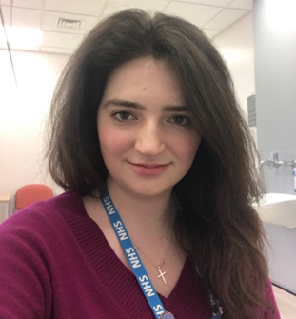
Speech and Language Therapy
I chose this particular role as I wanted to serve the community that I have grown up in and love. After university, I jumped at the chance of working back on the Fylde coast.
I have always had a heart to work within the NHS and started off thinking I wanted to be a doctor. I started to change my mind, (while sinking to the floor in a faint), when I watched a minor surgical procedure during work experience.
I have a close family member who has additional needs and I have grown to have an appreciation for the difficulties that those with additional needs can have. Over time, I particularly developed an interest in speech, language and communication. I did further work experience and worked as a medical receptionist in the NHS for a year and my heart became set on helping children with communication difficulties
I work across community clinic, mainstream schools and special schools. Very wide and very varied so never a boring day!
My job involves assessing and carrying out therapy with children who have a variety of different speech, language and communication difficulties; delayed speech/language, selective mutism, stammers, speech impediments, dyspraxia, cleft lip and palate, developmental language disorders, learning difficulties, hearing loss, syndromes such as Downs Syndrome, social communication difficulties such as Autism and the list goes on. I also lease and work with a wide range of other health and education professionals.
What’s the best thing about your role?
The difference you can make to a child. Communication affects so many other aspects of a life – self confidence, self-esteem, developing and maintaining friendships/ relationships, expressing wants, needs, thoughts, wishes, dreams, ideas etc. Working and getting to know families is wonderful. Having a child that is excited to come to therapy and is pleased to see you is wonderful.
Why should someone want to work in this role?
Its very challenging and stretching but also enjoyable, fulfilling and a privilege.
Lizzie Smith
Paediatric SALT
Community Service across Blackpool, Fylde and Wyre

Slide 4
Speech and Language Therapy
I chose to become as Speech Therapist after supporting children with Speech and Language difficulties whilst in a nursery role.
I am just being my career as a speech and language therapist since qualifying in June 2022.
My current role as band 5 in acute medicine is mainly focused on adults with dysphagia. I assess patient’s swallow functions with a varied diet and fluids consistencies and advised recommendations based on my clinical judgement from the assessment. Part of my role is to support patient who have been discharged from the hospital. Within this role I have 2 days per week in which I telephone patient to enquire if they require further Speech and Language Therapy input. This may include competed community visits myself or liaising with other Speech and Language Therapist to follow up with the patient in their own home setting.
What’s the best thing about your role?
I best thing about being a Speech and Language Therapist is the varied caseload. Each day is different; therefore, the learning never stops!
What makes Speech and Language Therapy great is the impact you have upon a patient’s quality of life.
Why should someone want to work in this role?
You should become a Speech and Language Therapist if you want to help people in their communication/swallowing to regain independence and enjoyment in their daily lives.
Leigh Maymond
Speech and Language Therapist. Acute Medicine

Slide 5
Support Worker Profiles
I chose this role as I know I needed to a change in my career. I didn’t have my heart set specially on Speech and Language Therapy when applying for the post.
Over the past three years, I feel personally I have come a long way and have achieved much more than I thought I was capable of! I have completed studies at UCLAN alongside work up until completing this year. Prior to completing my degree to support with this current role, I always had doubts and felt like my dyslexia and dyspraxia held me back, but I know for sure this has overturned and I feel much more positive in all aspects of my working/studying time so far!
My current role involved patient facing work (Face to face visits, phone reviews and planning.) I lead on Motor Neurone Disease (MND) patients and Voice banking. I liaise with internal and external professionals/companies. I allocation of all Speech and Language Therapy (SLT) appointments, booking Interpreters. I also complete assistant List Tasks, which include completing tasks for therapists such as onward referrals, reports and producing communication books/charts. General management of Communication aids / Dysphagia utensils, Dysphagia Competencies / Mandatory Training. Ear Nose and Throat (ENT) work. I also train other staff members, support QI project work and offer Band 4 Peer Supervision every 3 months.
What’s the best thing about your role?
At present I can say there is not one thing I don’t like about my job! I wake up everyday and want to come to work. All aspects of my job I love, and it makes it much better that I have such an amazing team!!
Why you should someone want to work in this role?
Making a significant impact on patients’ lives, having support from all colleagues, good teamwork and constant learning opportunities
Lauren Prestage
Assistant practitioner, Speech and Language Therapy

Slide 6
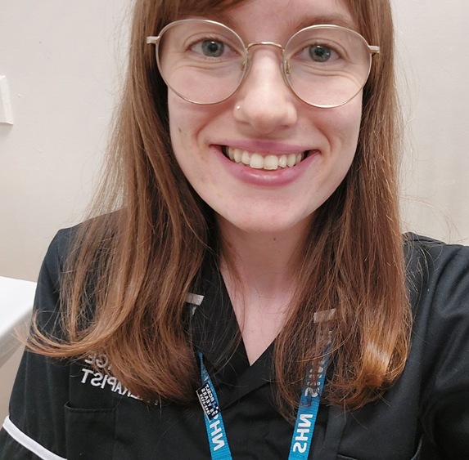
Speech and Language Therapy
I chose to become an Speech and Language Therapist )SLT) because I knew I wanted a career where I was helping other people. I did some relevant voluntary work and shadowed some SLTs, and knew this was the career for me!
I graduated from Leeds Beckett University in 2017. My first job was a mixed community/acute post, working with adults with acquired communication & swallowing difficulties. I was in this post for three years and this is where I did my post-graduate dysphagia training. I then worked in a Community Learning Disability Health Team for two years, before starting my current role at East Lancashire Hospital Trust (ELHT).
I’m currently a SLT working with adults with acquired communication and swallowing difficulties in the community. This involves visiting people in their own homes to complete initial assessments and follow-ups. I also do initial telephone and video assessments, and visits, for our care home residents. We work with the person, the people around them and the wider Multi Disciplinary Team (MDT) to support the person to achieve functional, holistic goals and manage long-term health needs.
What’s the best thing about your role?
Communication and eating & drinking are so important. Being able to support someone to communicate effectively, and/or eat & drink safely, is a brilliant feeling.
We’re a small profession, but we make a big difference!
Why should someone want to work in this role?
You should become an SLT because it’s so varied, and there are so many specialisms and areas that you can work in. There’s always more to learn!
Jess Longstaff
Speech & Language Therapist
ELHT Community Speech & Language Therapy team

Slide 7
Speech and Language Therapy
When I was a child I remember watching a movie about Helen Keller and being absolutely fascinated with her story of how she learnt a new way to communicate using finger spelling. When I finished school, I was at a loss about what I wanted to do. I was flicking through the university course books and chanced upon Speech Pathology (as it is called in Australia). I thought about the movie I had watched as child and decided I would like to help others who had difficulty communicating. My mum, who is a teacher, strongly encouraged me to apply to do the degree and now here I am!
My journey started at the Flinders University of South Australia in Adelaide, Australia. Once I graduated, I won a position of a sole Speech Pathologist at a small country hospital, providing services to both inpatient and outpatient children and adults. Following a year stint in Queensland, working with children on the autism spectrum and their families, I packed my bags and headed to the UK for a two-year working holiday. For the next two years, gained experience working in various community and hospital settings in the north-west, I also gained my now husband. After 13 years in Australia, we moved back to the UK. I gained a position as the community lead SLT within the BVH Adult SLT team where I worked for nearly 2 years before moving to my current role.
I am currently a Specialist Senior Speech and Language Therapist working within the Integrated Community Stroke and Neurorehab service. I predominately provide SLT services to people who have a neurological condition such as MND, Parkinsons, Huntingtons Disease. This involves assessing and managing both communication and swallowing disorders. This can involve optimising a person’s ability to communicate with others, this may be verbally or through the use of an alternative communication system. It may also involve assessing a person’s swallow and providing strategies and recommendations to optimise swallow safety, improve oral intake and maximise quality of life.
What’s the best thing about your role?
Being a SLT is the massive change you can make to someone’s life, whether this be helping them to communicate with others or providing comfort and reassurance to a family member. I recently had a patient with Parkinson’s Disease tell me I had “returned something so very precious.” These moments are the best thing about the job. I strongly value working within a strong, supportive team. The comradery, the shared learning and the friendships made are invaluable.
Why should someone want to work in this role?
SLT is a fantastic and rewarding profession to join. It is a very unique profession, in that there are so many areas of specialism to explore. It is an exciting and varied career. It can lead to other opportunities in leadership, research or clinical education. It allows you a high degree of flexibility and has excellent employment prospects both here in the UK and abroad. And lastly, but most importantly, it offers you the chance to truly make a difference to patients and their significant others.
Greta Garnett,
Specialist Senior SLT, Integrated Community Stroke & Neurorehabilitation Service

Slide 8
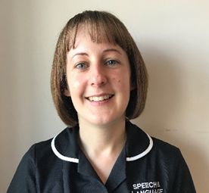
Speech and Language Therapy
I chose to become a Speech and Language Therapist (SLT)because I wanted a career that would be rewarding, where I could make a difference to people’s day to day lives. I really enjoy meeting patients, establishing therapeutic relationships and working through their communication/swallowing difficulties within their own environment.
When I first qualified as an SLT I began working with children in both community clinics and schools targeting both speech sounds and language development. My post at this time was rotational which meant I had 3 days working with children and 2 days where I could rotate around the whole SLT service. This gave me such a broad insight and experience into SLT services across many different clinical areas including voice, brain injury and adults with learning disabilities.
I became very interested in dysphagia and further down the line in adult acquired disorders, particularly Motor Neurone Disease. My job role changed as I began working on acute wards, rehab wards within community hospitals and then on to patients in the community all with acquired dysphagia.
I am community based and work with adults with acquired speech, language and swallowing disorders. The majority of patients on my caseload have a long-term progressive or degenerative condition. Most of my work is within patient’s own homes, nursing/care homes or the local hospice.
My responsibilities include providing assessment and advice to patients and carers and delivering therapy where indicated. I am also involved in providing dysphagia training, liaison with the wider multi-disciplinary team including specialist Nurses, Physios and Occupational Therapists. Occasionally I carry out joint visits with the Dietitian where it is felt a joint approach would be useful for the patient. I regularly assist the clinical lead SLT in the joint practitioner lead videofluoroscopy (VF) clinic. This involves conducting a swallow assessment under x-ray conditions, analysing the findings, writing a detailed report and providing objective swallow recommendations.
My role also includes supervising several junior members of staff (band 5 rotation), and assistants, and taking an active part in their dysphagia training. I am also one of two safer handling facilitators for SLT. I am jointly responsible for delivering update training to all SLTs and reviewing current moving and handling risks and their standard operating procedures. I attend regular meetings with other facilitators and the safer handling leads for updates which I then cascade to my team.
What’s the best thing about your role?
The best thing about being an SLT is that no two days are the same. The patients, the interactions with them and their families are what make each day different. As a profession SLTs are great team players and fully advocate a holistic approach. In my experience SLTs often go the extra mile for their patients and are fully supportive of their colleagues.
Why should someone want to work in this role?
Speech and Language Therapy is such a diverse profession spanning many different clinical areas. Its challenging, rewarding, interesting, relatable and continues to strive to be innovative within the scope of practice.
Barbara Denton
Speech and Language Therapist, Burnley General Hospital

